Slide 1
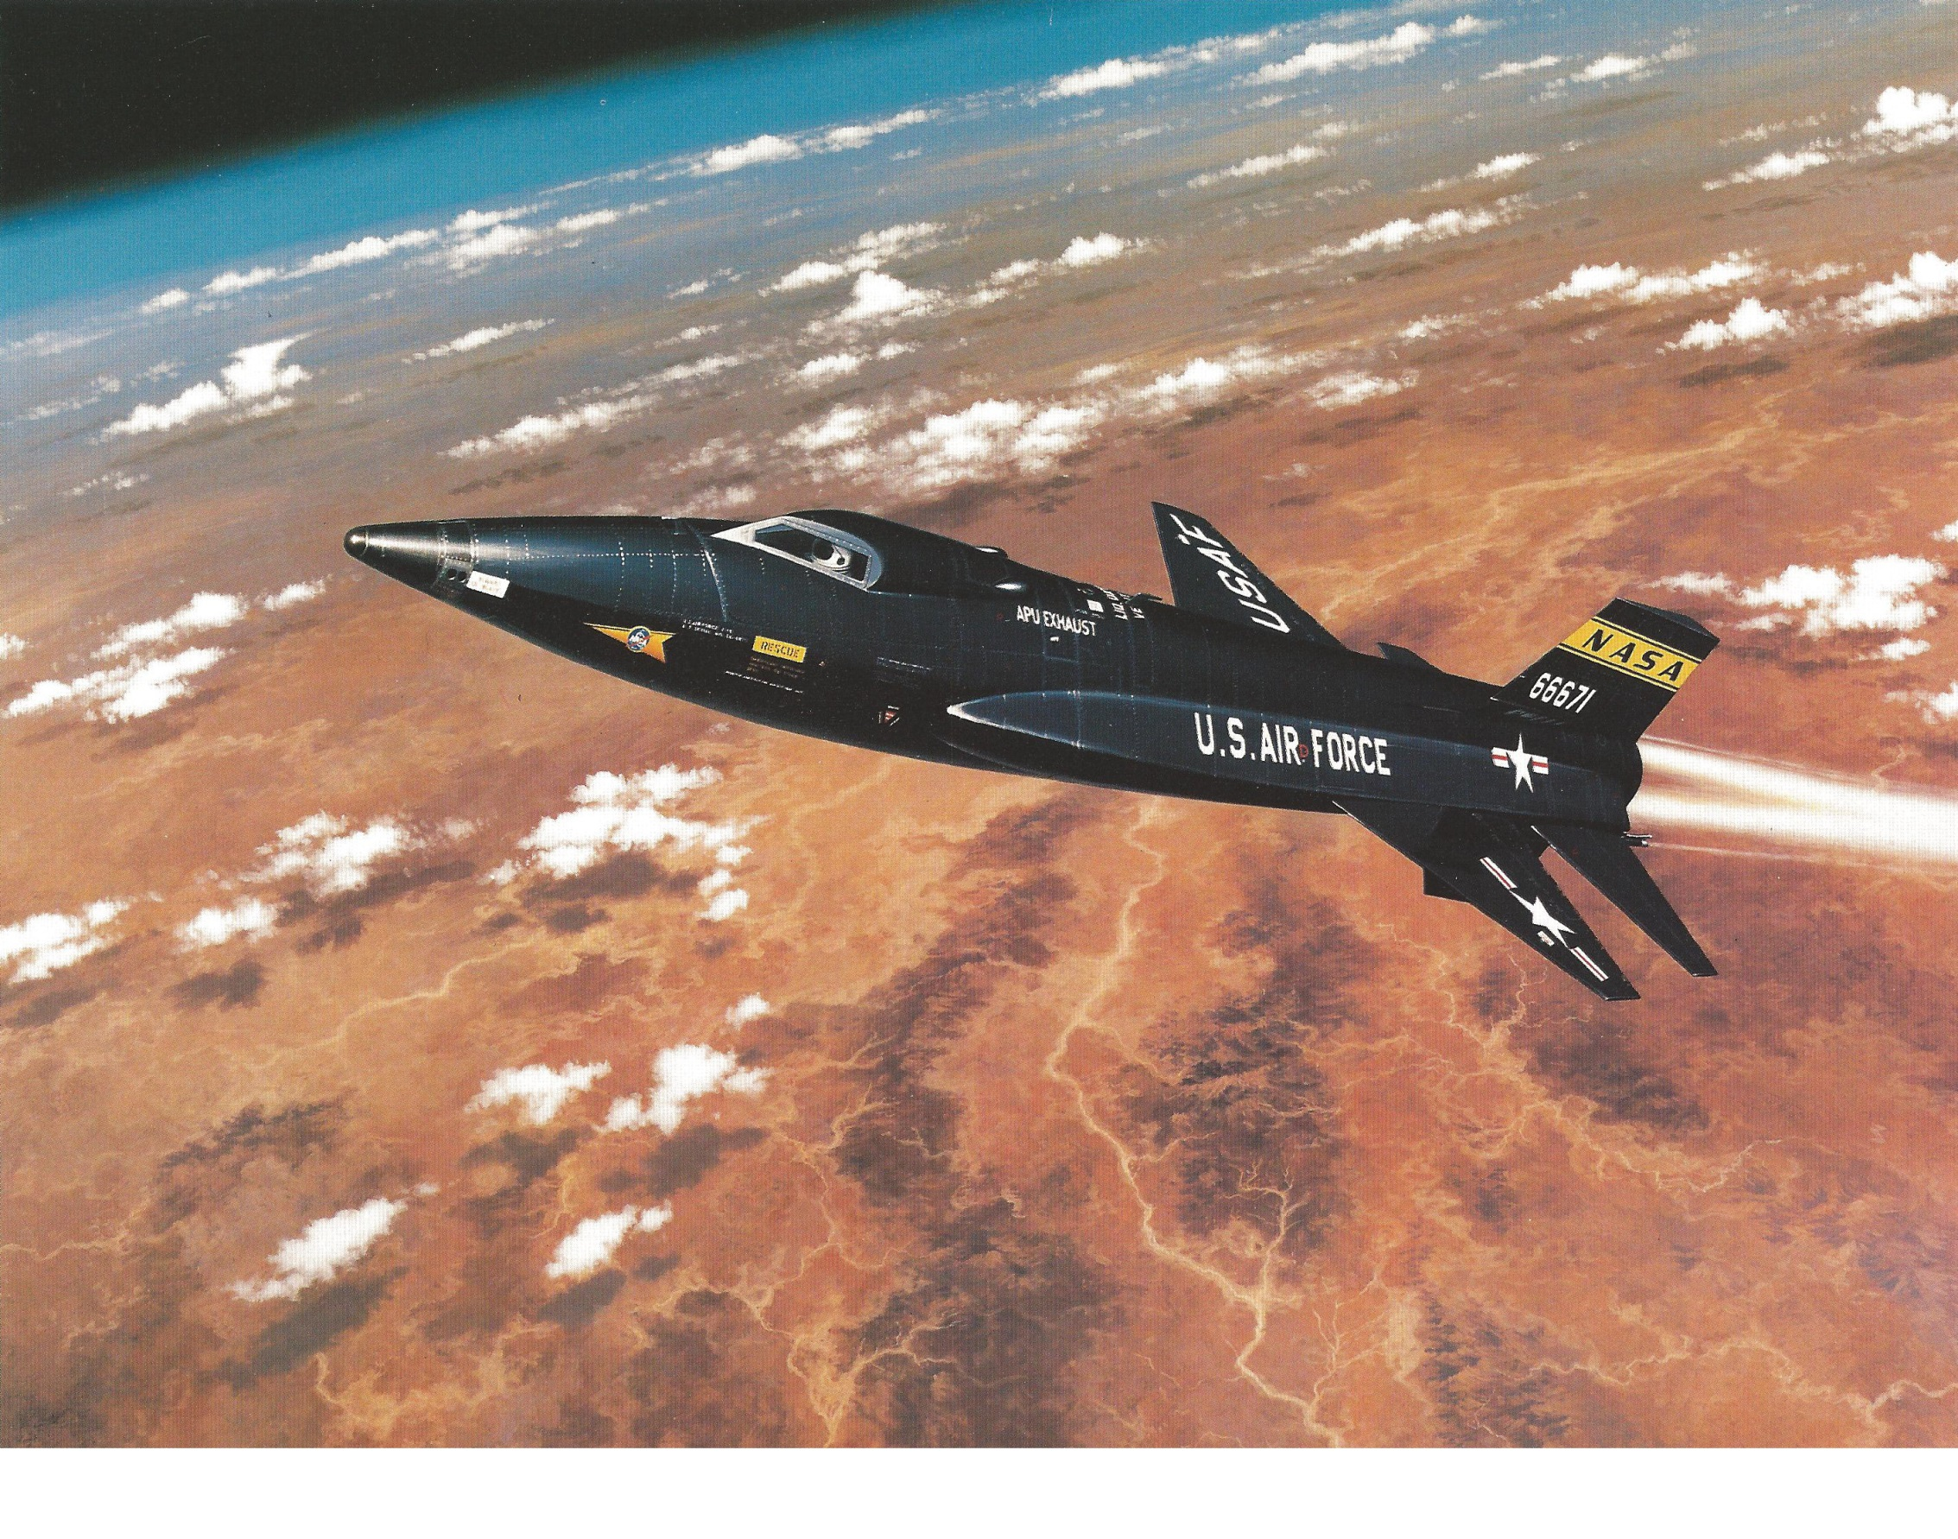
X-15 world altitude record flight

Slide 2
Summary of Flight 3-7-14, 17 July 1962
X-15 pilot: Major Robert M. White
Flight track: Delamar Dry Lake to Edwards (Rogers Dry Lake)
Planned Actual
Maximum Altitude: 282,000 ft 314,750 ft
Maximum speed: 5.15 5.45 Mach
: 3,832 mph
Duration of flight: 10 min. 20.7 sec
Powered (rocket-burn) duration: 80 sec 82.0 sec
Total distance flown: Horizontally -- ~235 miles ~ 315 miles
Vertically -- ~98 miles ~ 110 miles

Slide 3
The middle part of this presentation will simulate the flight automatically automatically in real time, from X-15 launch to landing. This covers 10 minutes 20 seconds.
One embedded video clip will run 2.4 times faster than real time, shot at 10 frames per second from a rear-facing camera on the X-15. This covers the part from launch to rocket engine shutdown. The end of this clip synchronizes with real time in the flight simulation.
A video clip synchronized with the end of this flight shows an actual X-15 turn to final approach and landing on the lakebed. The clip includes the end of the Heading Alignment Circle.
An “encore” video clip appended just after the real-time landing shows an additional X-15 landing. This provides a good view of final approach and landing with two F-104 chase planes, as occurred on this flight with Chase 4 and Chase 2.

Slide 4
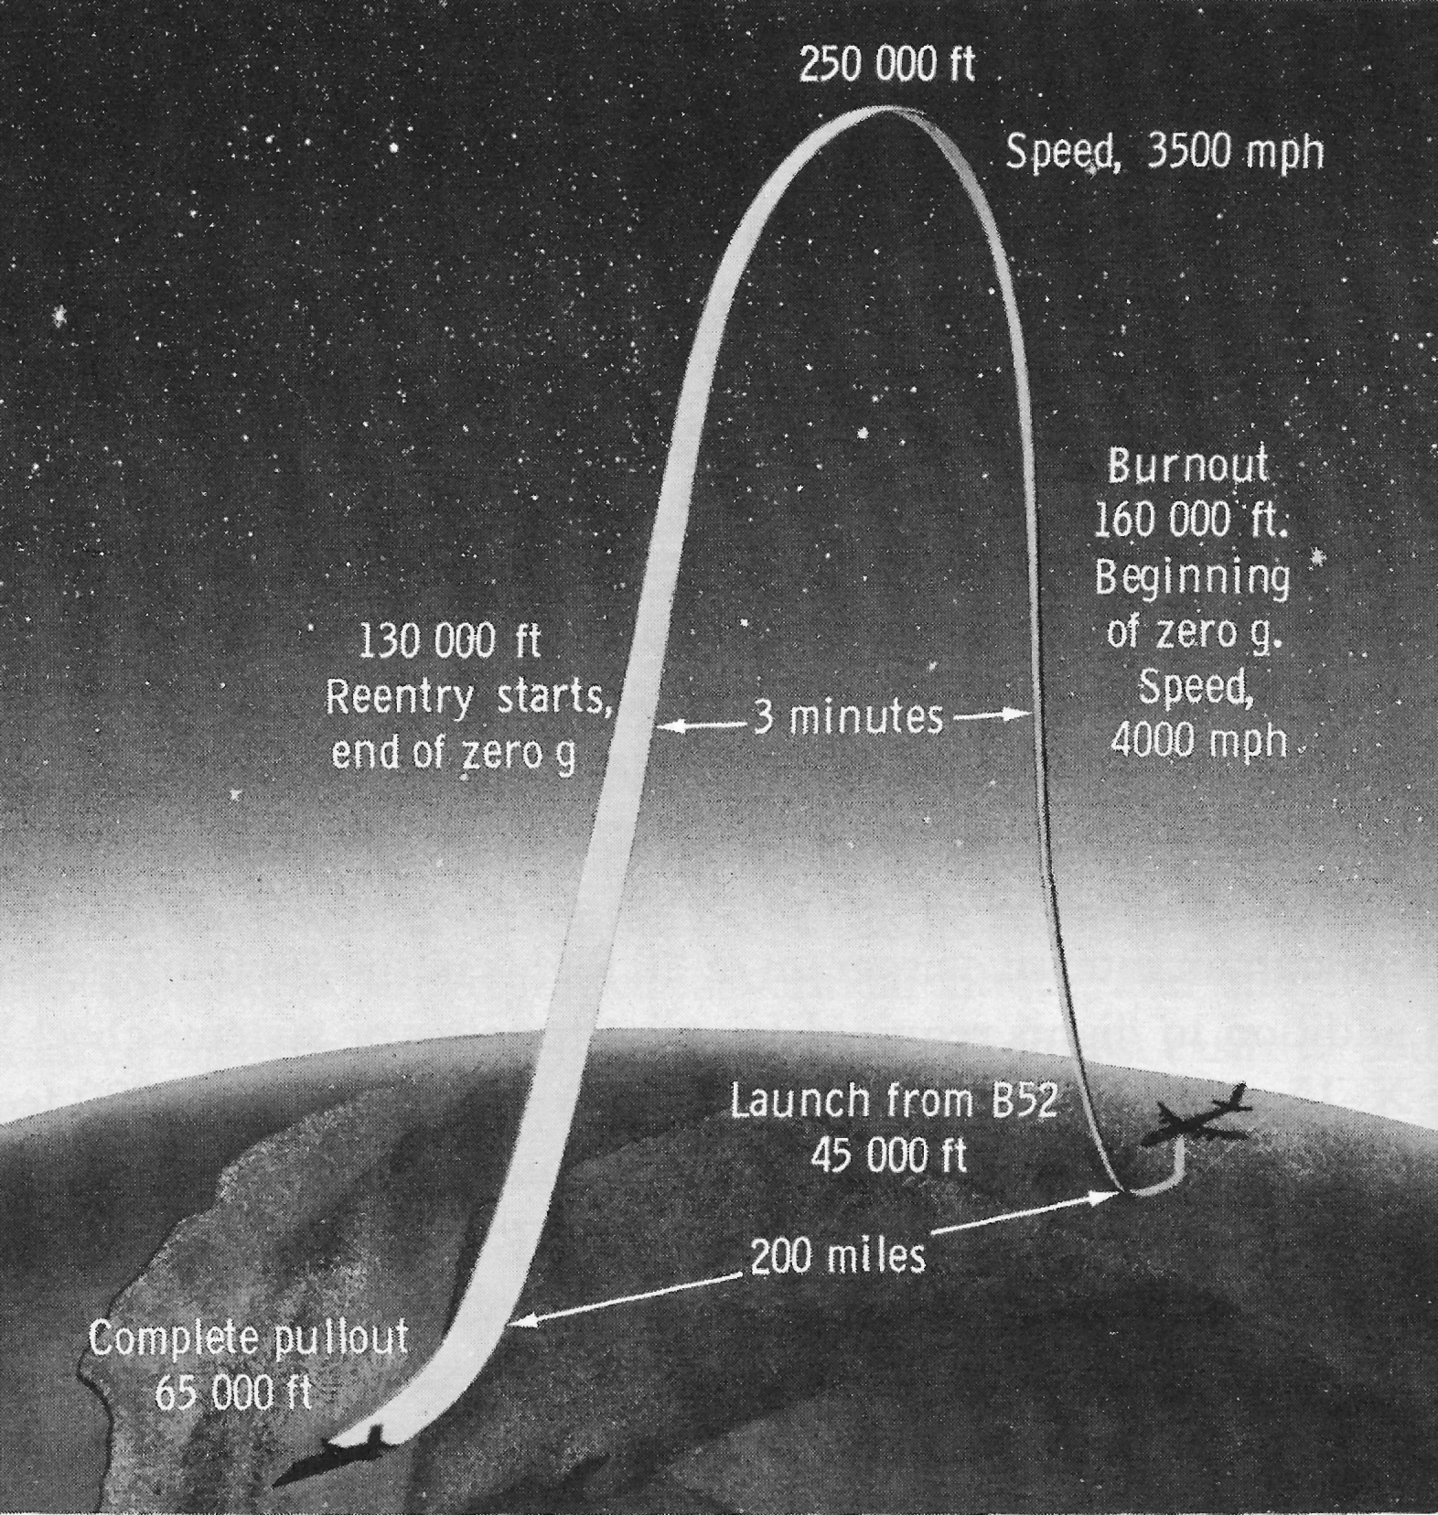
Speed & altitude
in an X-15
high-altitude
flight

Slide 5
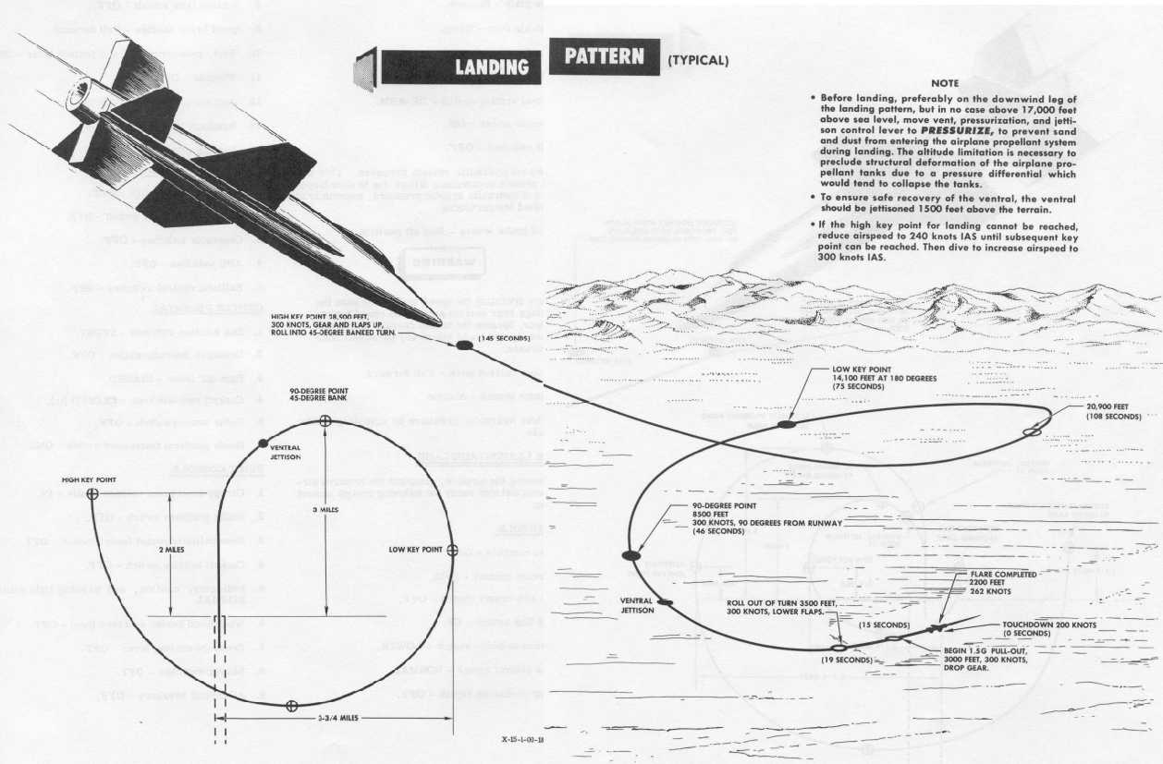
Ideal landing approach:
Reach high key at 29,000 feet & 300 knots (345 mph)
High Key point:
29,000 feet @ 300 knots

Slide 6
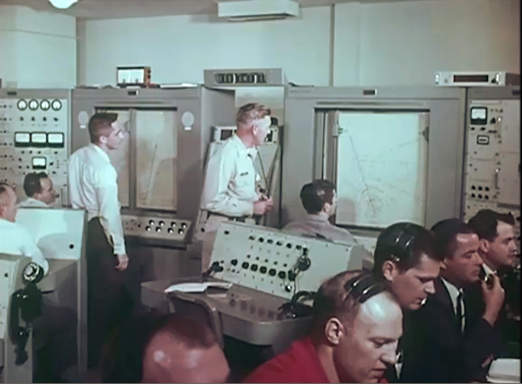
The most important source of data on this flight
is the plot of the ground track and altitude track.

Slide 7
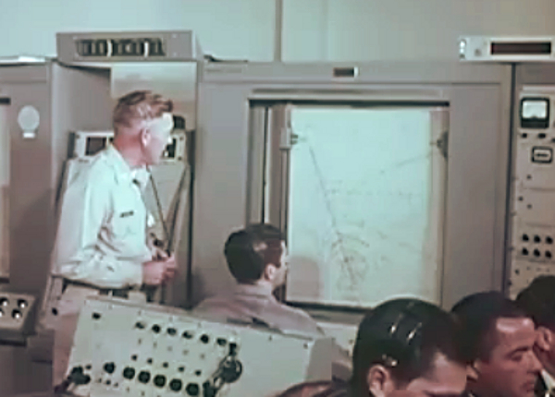
On this flight the plotter’s left pen drew altitude,
right pen drew ground track

Slide 8
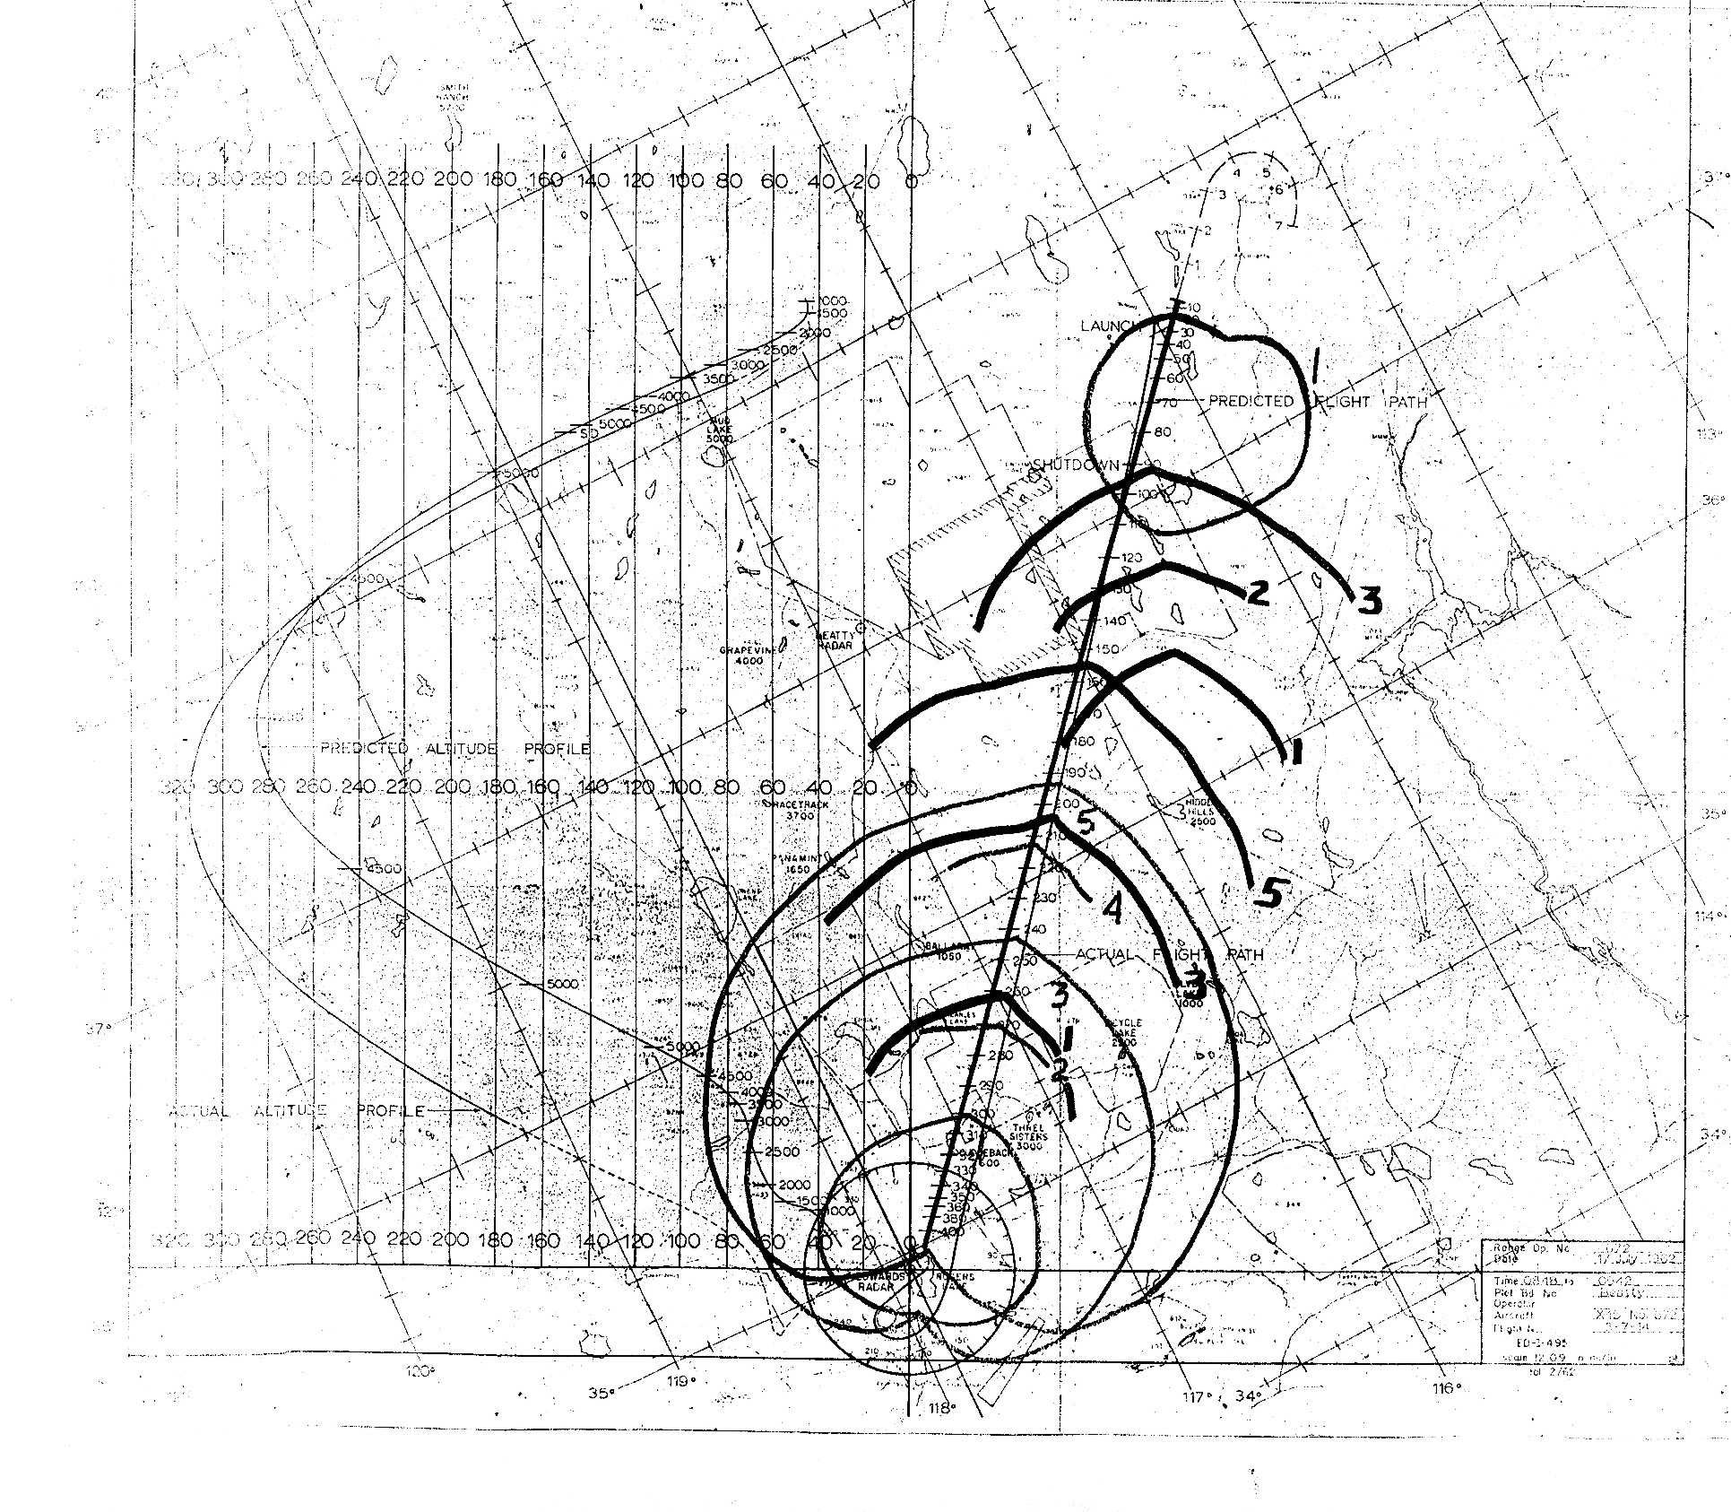
Raw copy of plot: Scan of copy of copy of copy of the original
Hand-drawn cardioid patterns for X-15 emergency glide range planning
will be edited out in this presentation’s flight track plots.

Slide 9
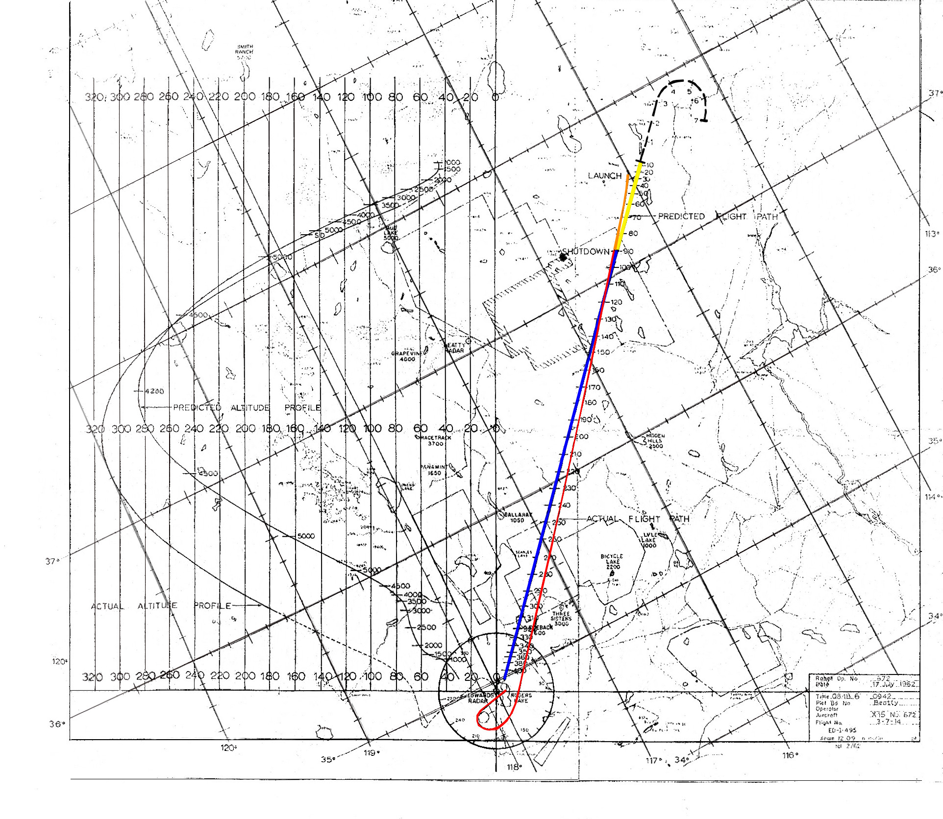
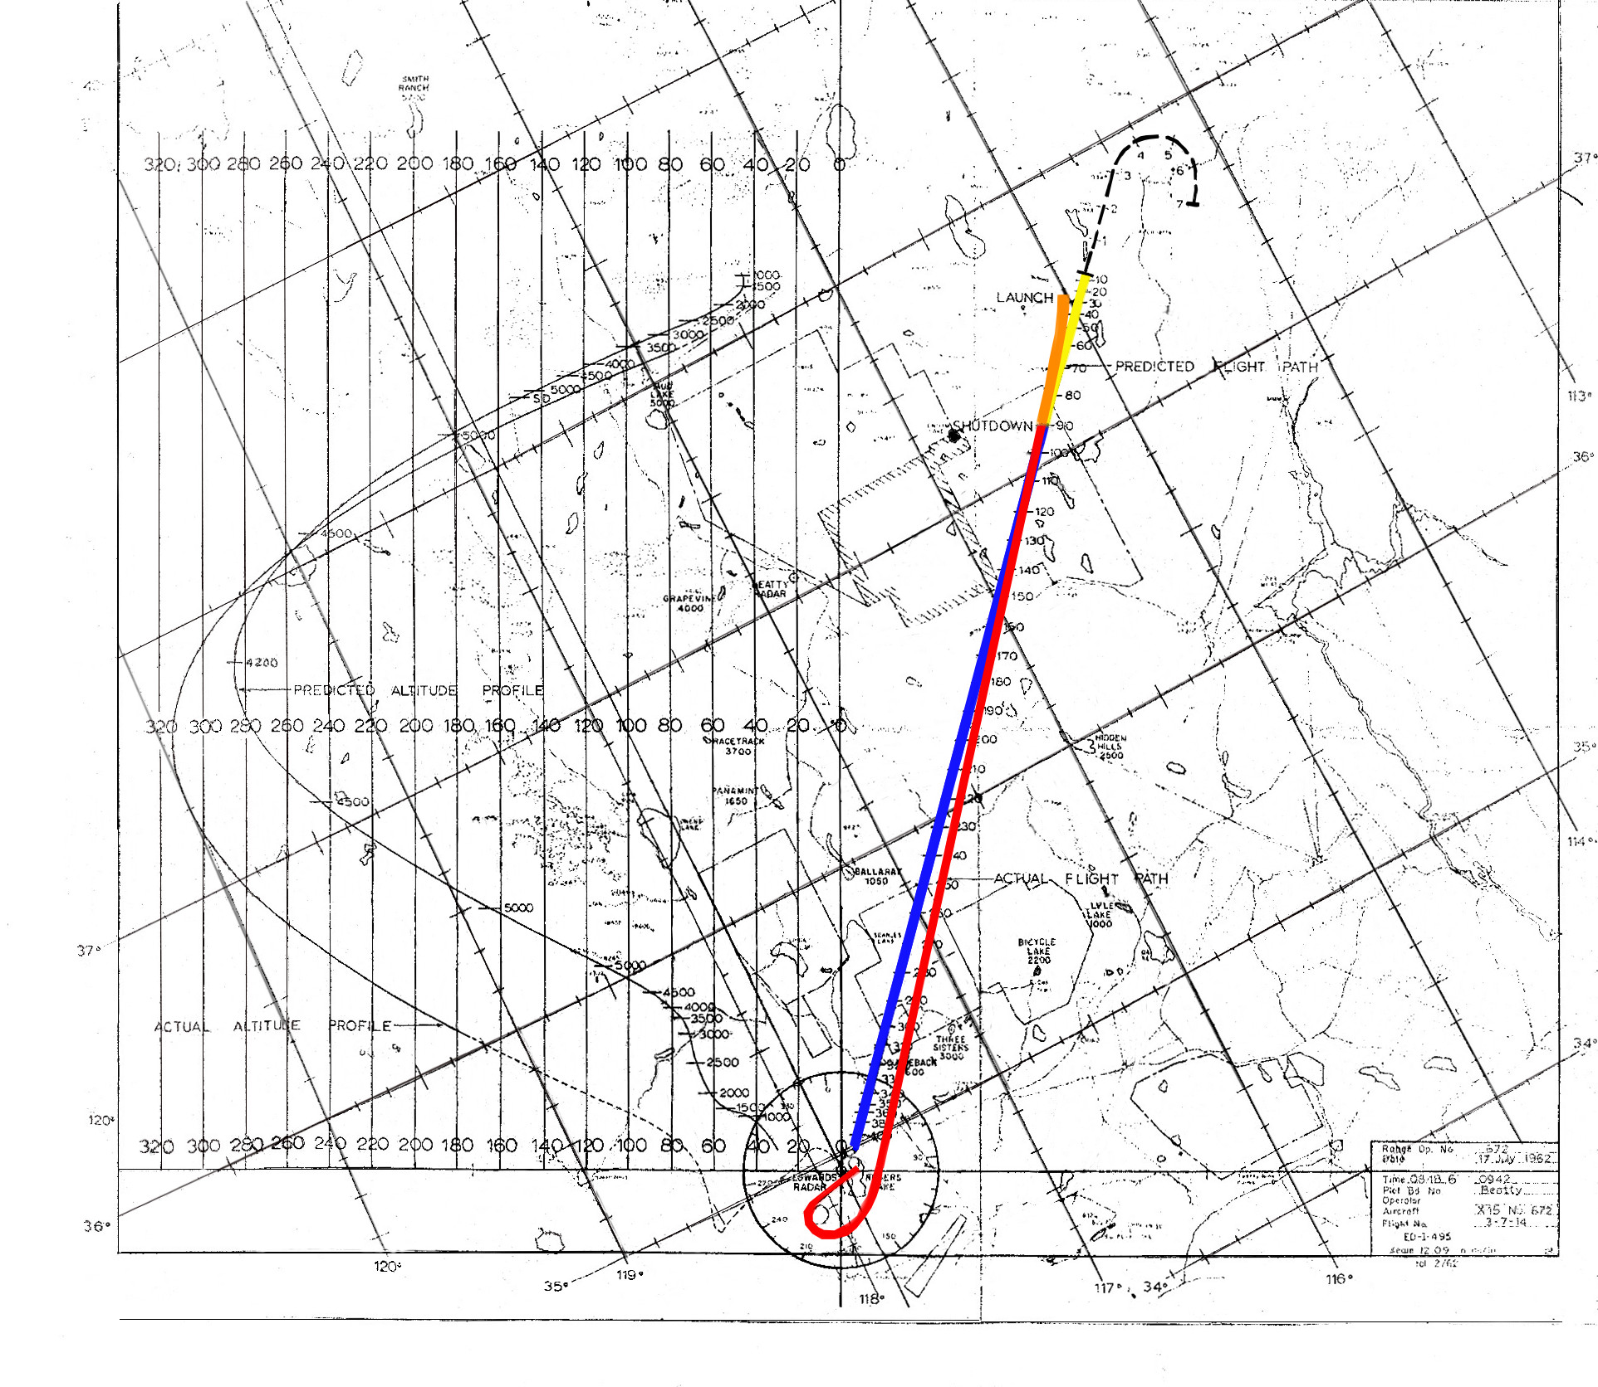
Graphically cleaned up & ground track color-enhanced…
Planned
Flight
Actual
Flight
Colors
Launch to rocket engine shutdown
After shutdown, coasting & gliding

Slide 10
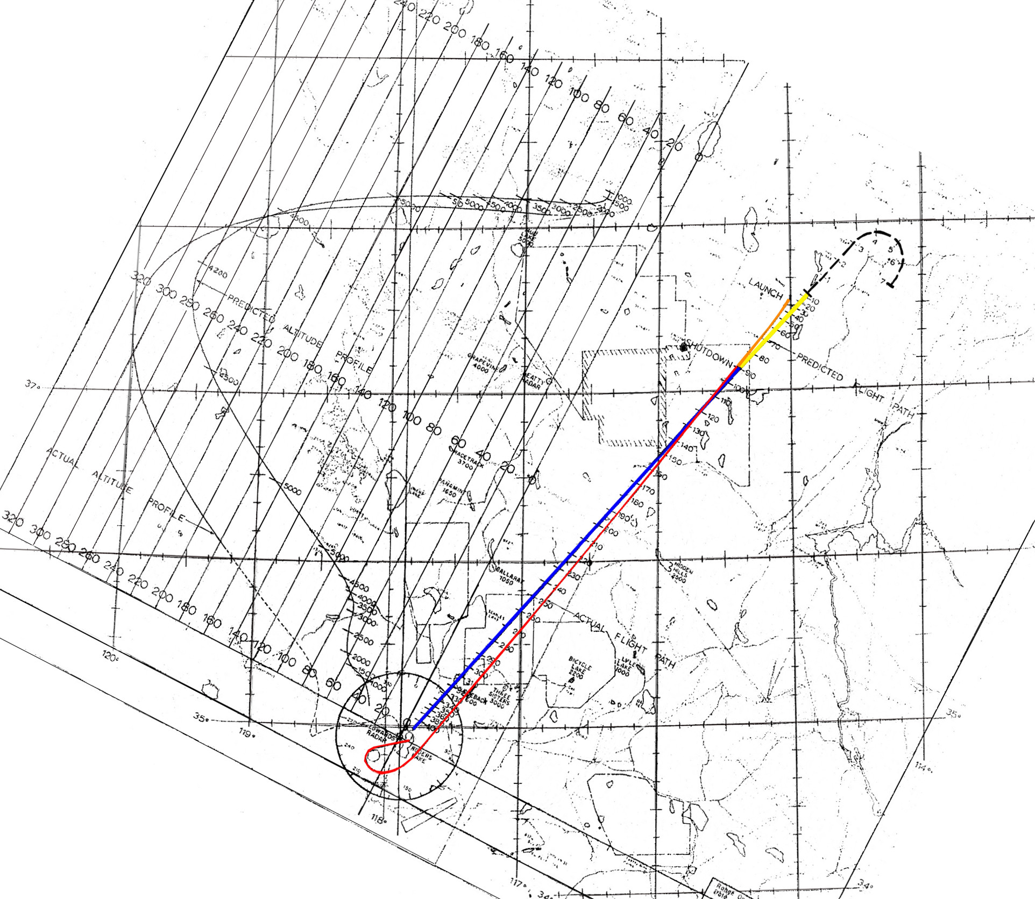
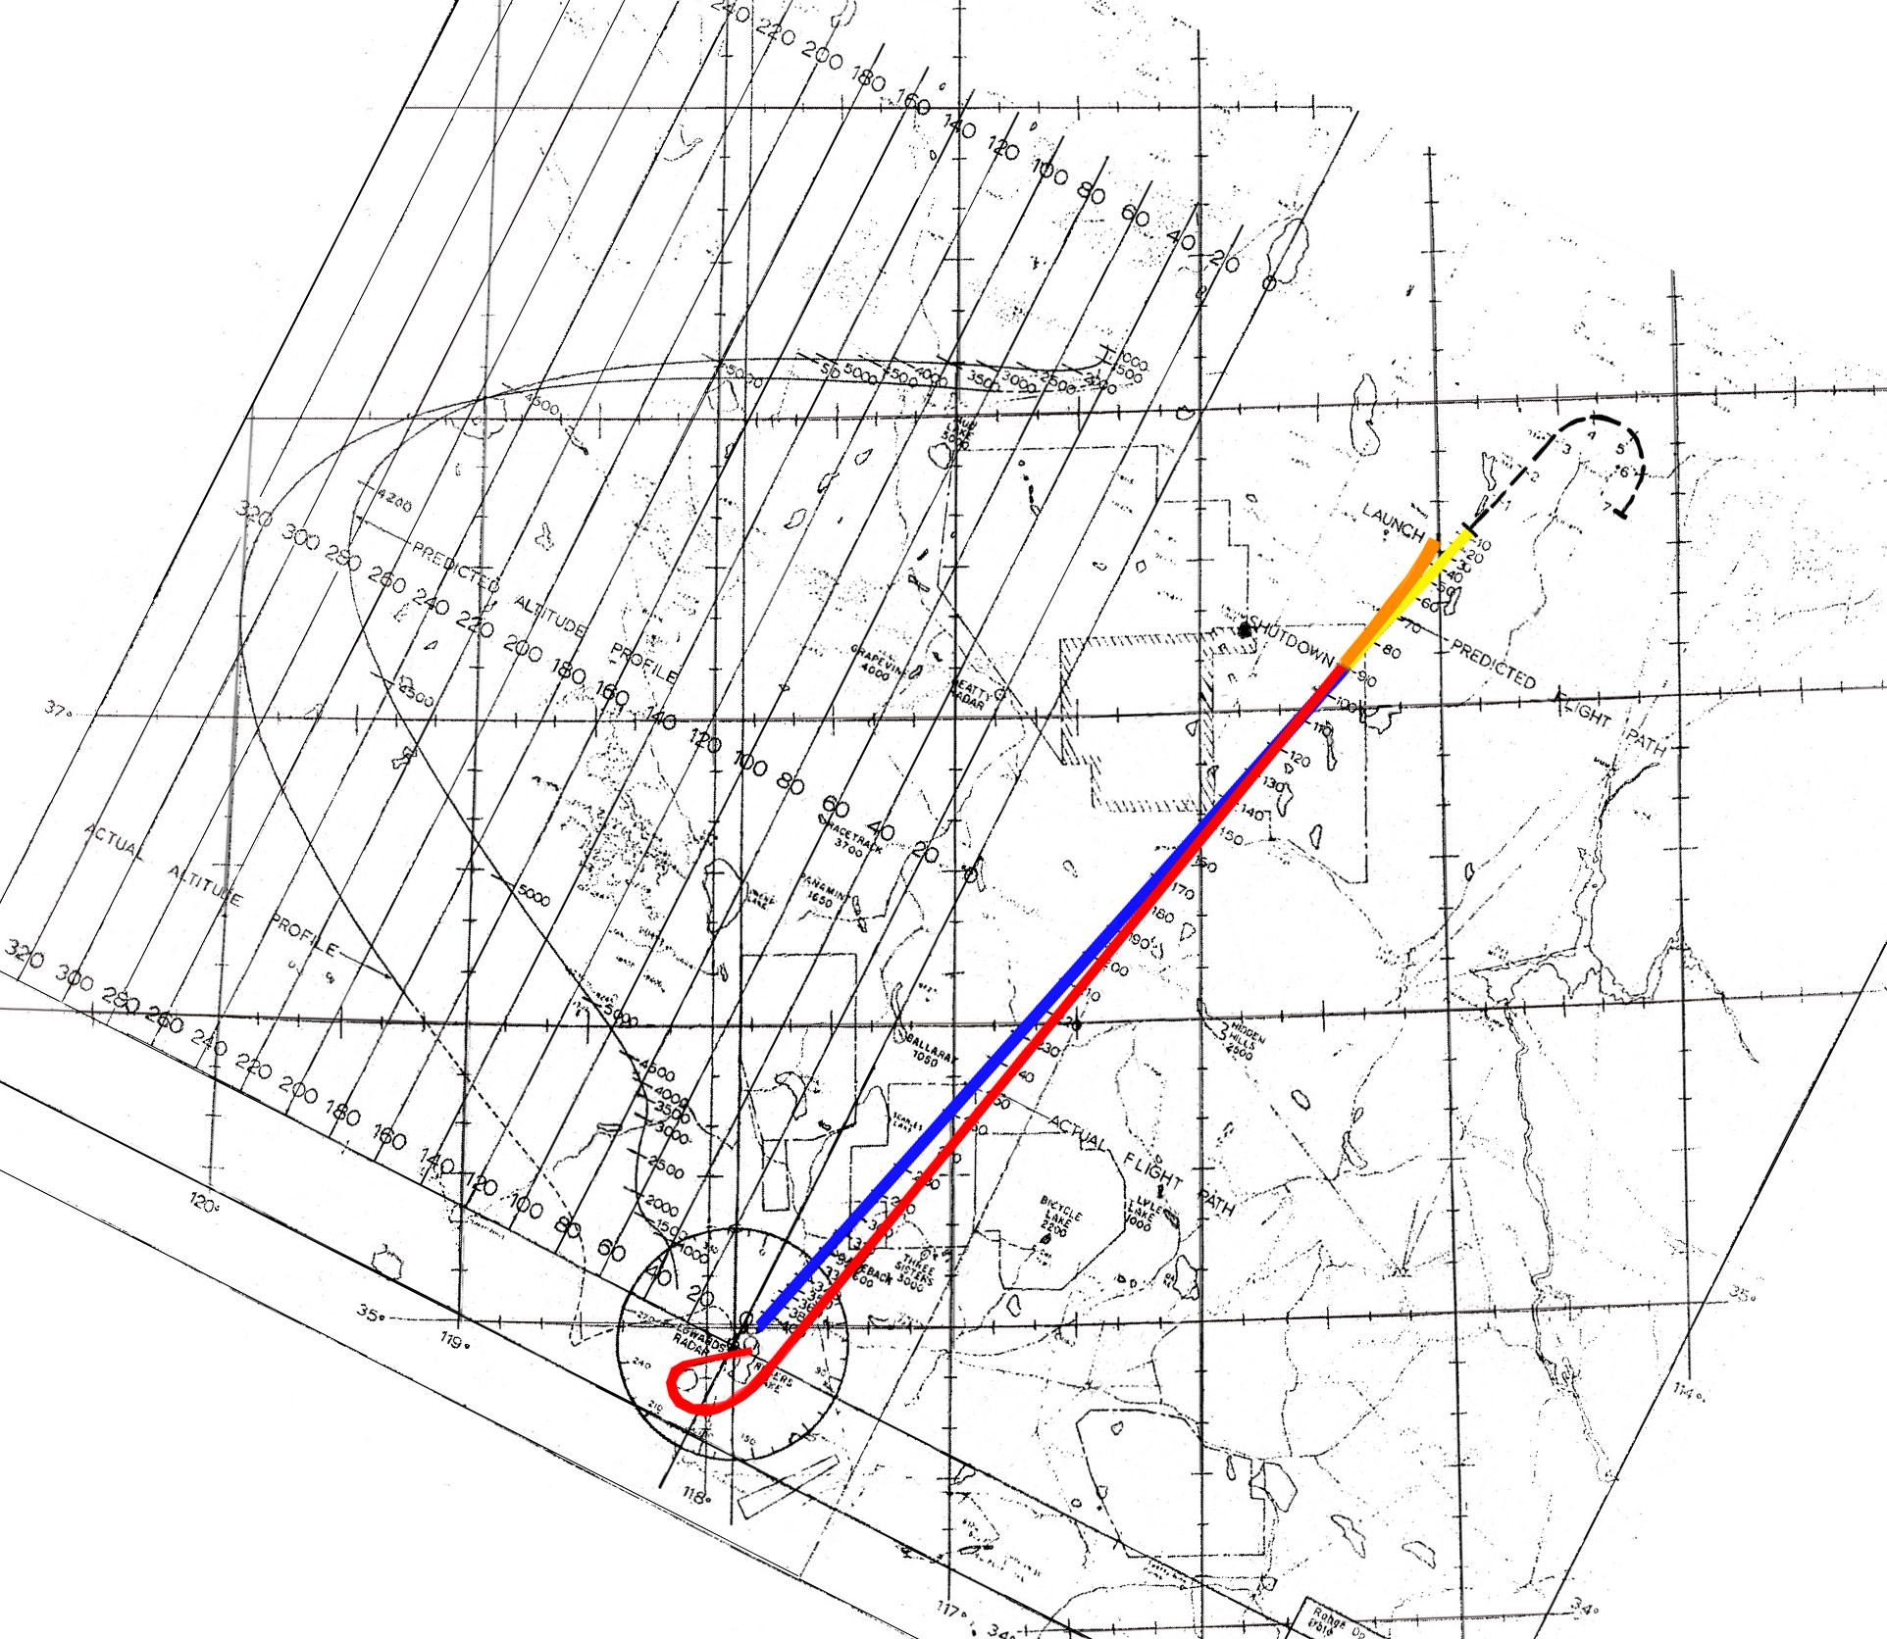
Rotated to normal map orientation:
North-south vertical
East-west horizontal

Slide 11
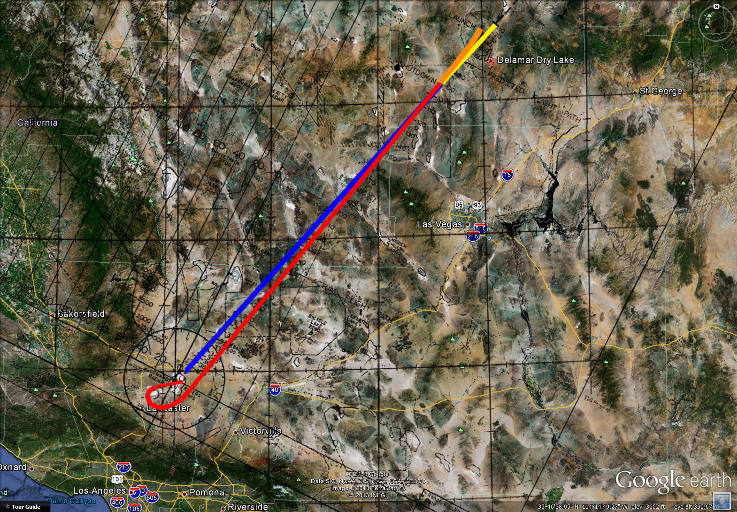
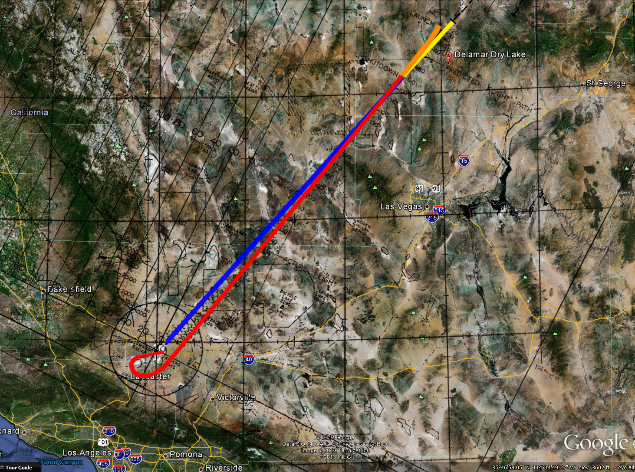
Ground track over Google Earth map
Launch near
Delamar Dry Lake
St George
Utah
Las Vegas
Bakersfield
Edwards
AFB
Barstow
Los Angeles

Slide 12
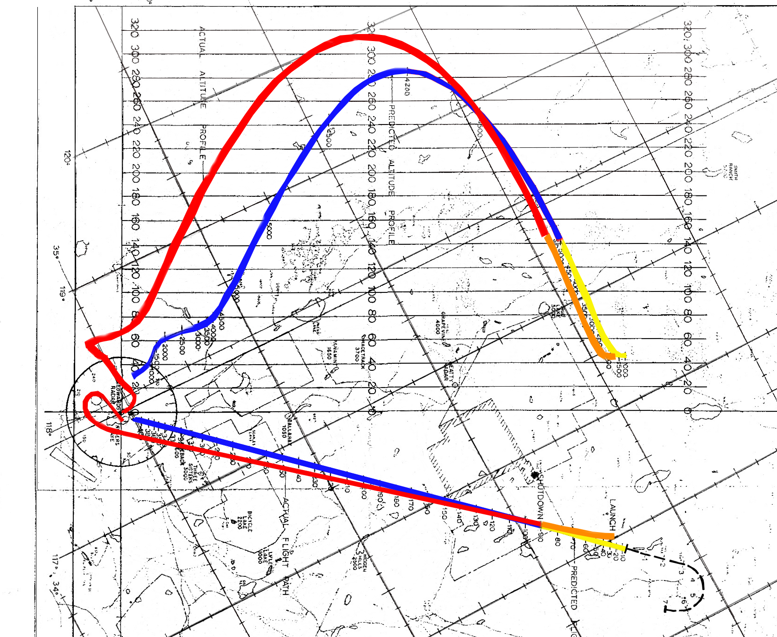
Rotated to show
altitude profile

Slide 13
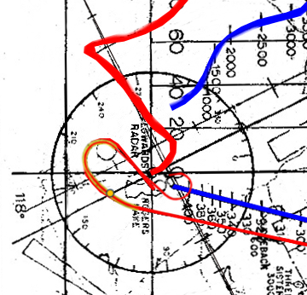
Prebriefing:
Altitude and
Ground Track,
Reentry to Landing
North/South orientation

Slide 14
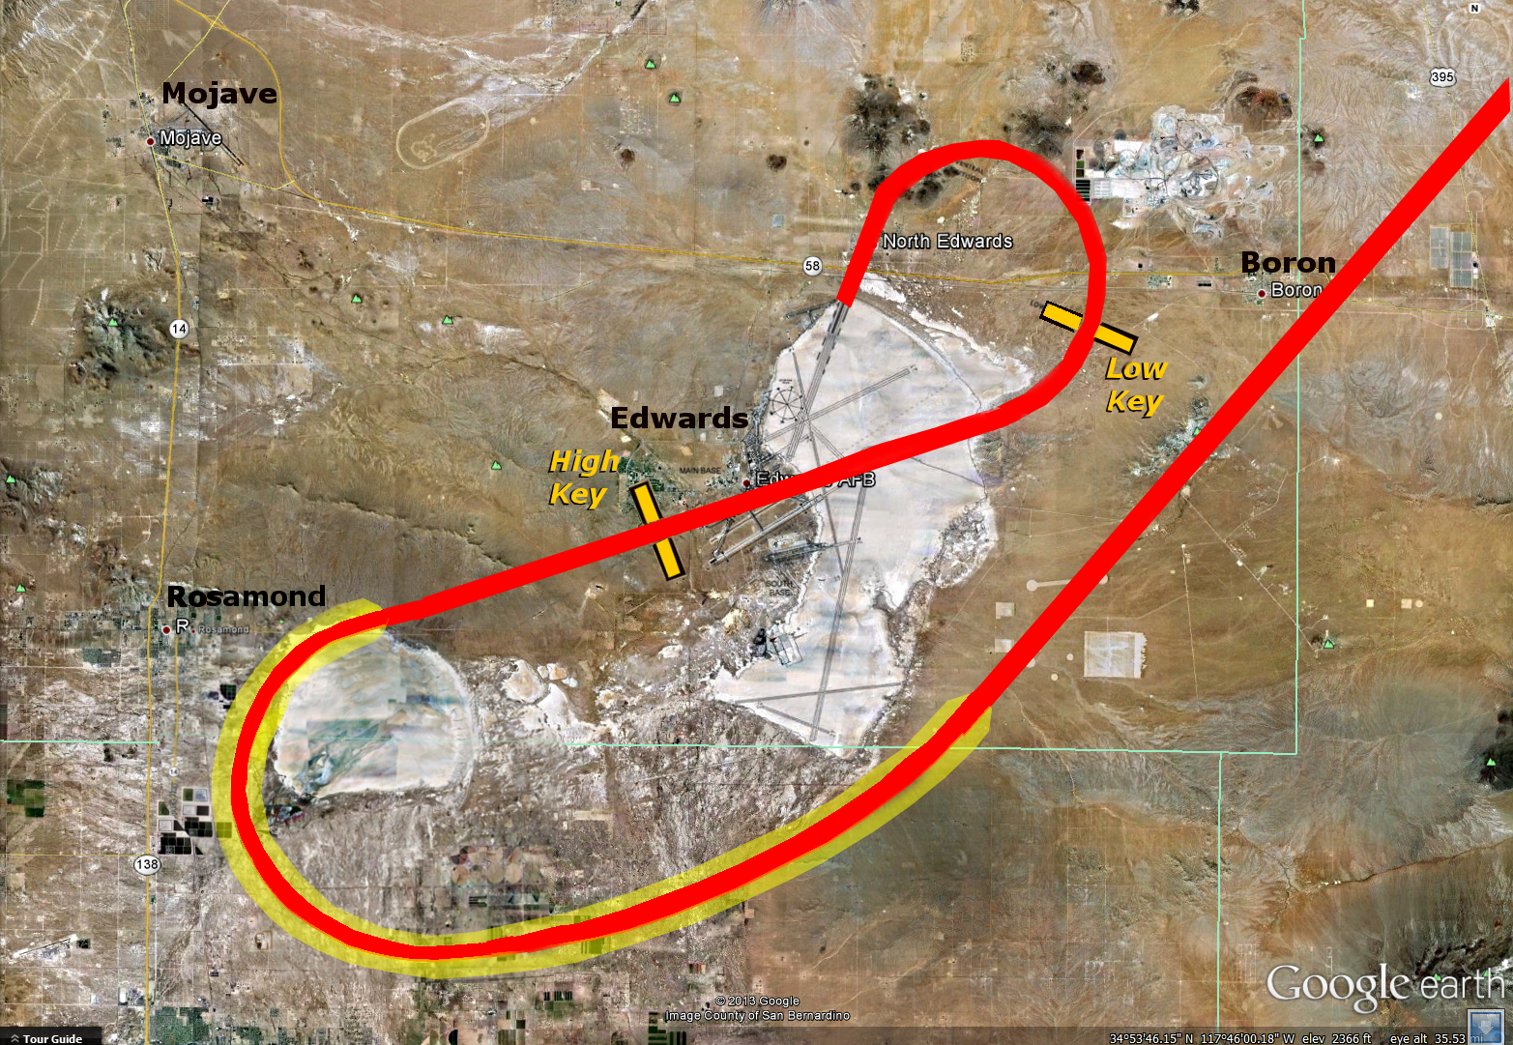
Mach 3
6:10
60,000 ft
1,770 mph
End of Reentry
High
Key
Preview

Slide 15
Preview: Altitude profile,
reentry to landing
160,000 ft
3,800 mph
In 50 seconds…
slowing by
~ 1,800 mph
diving ~ 100,000 feet
with 5G pullup
Reentry
100,000 ft
3,500 mph
60,000 ft
2,000 mph
30,000 ft
High-G turn back while
overshooting Edwards,
Start of dive toward landing pattern
345 mph

Slide 16
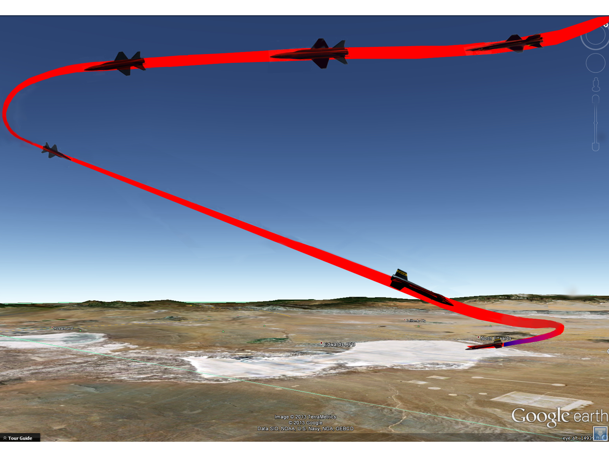

Slide 17
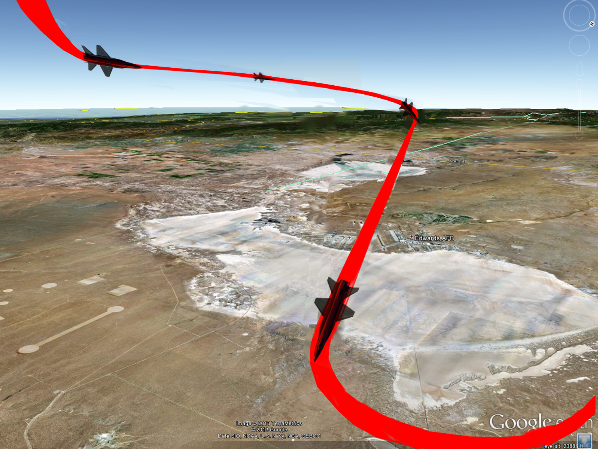

Slide 18
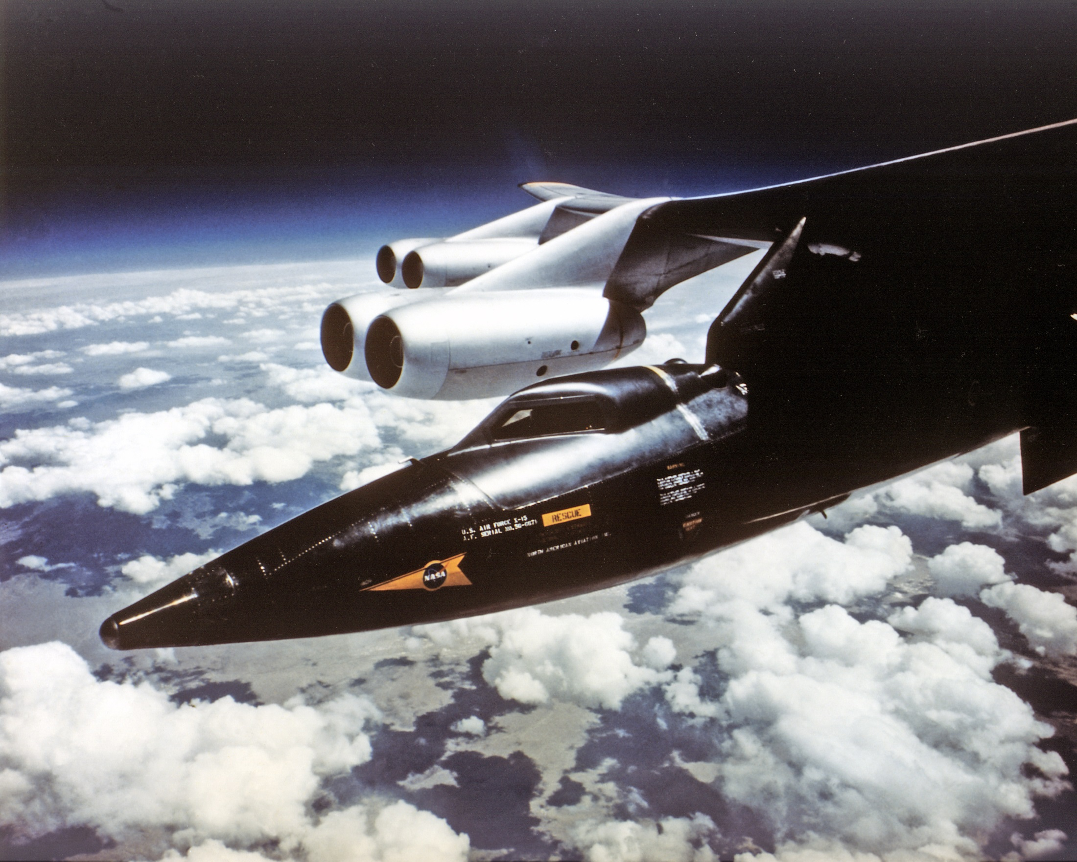

Slide 19
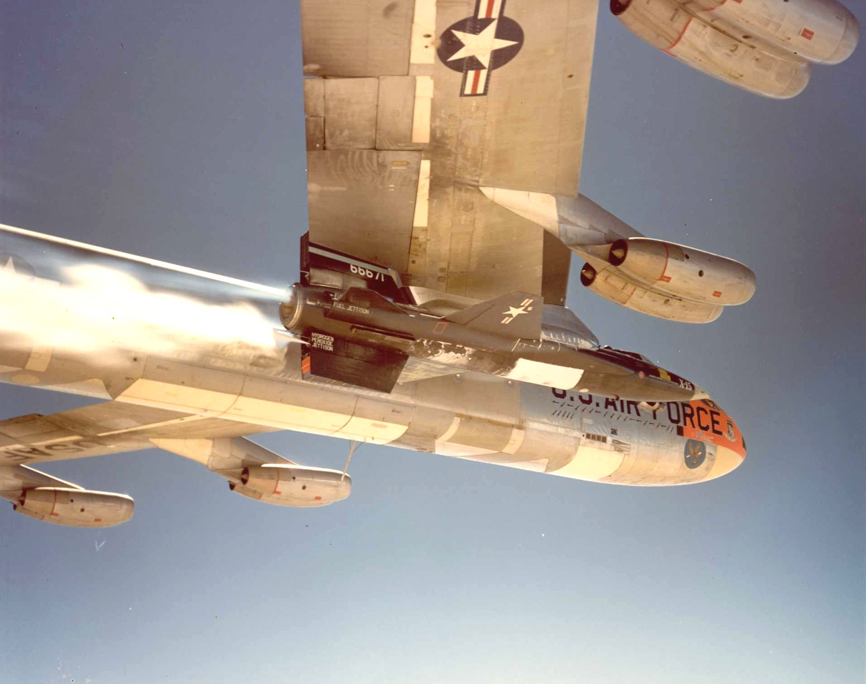

Slide 20
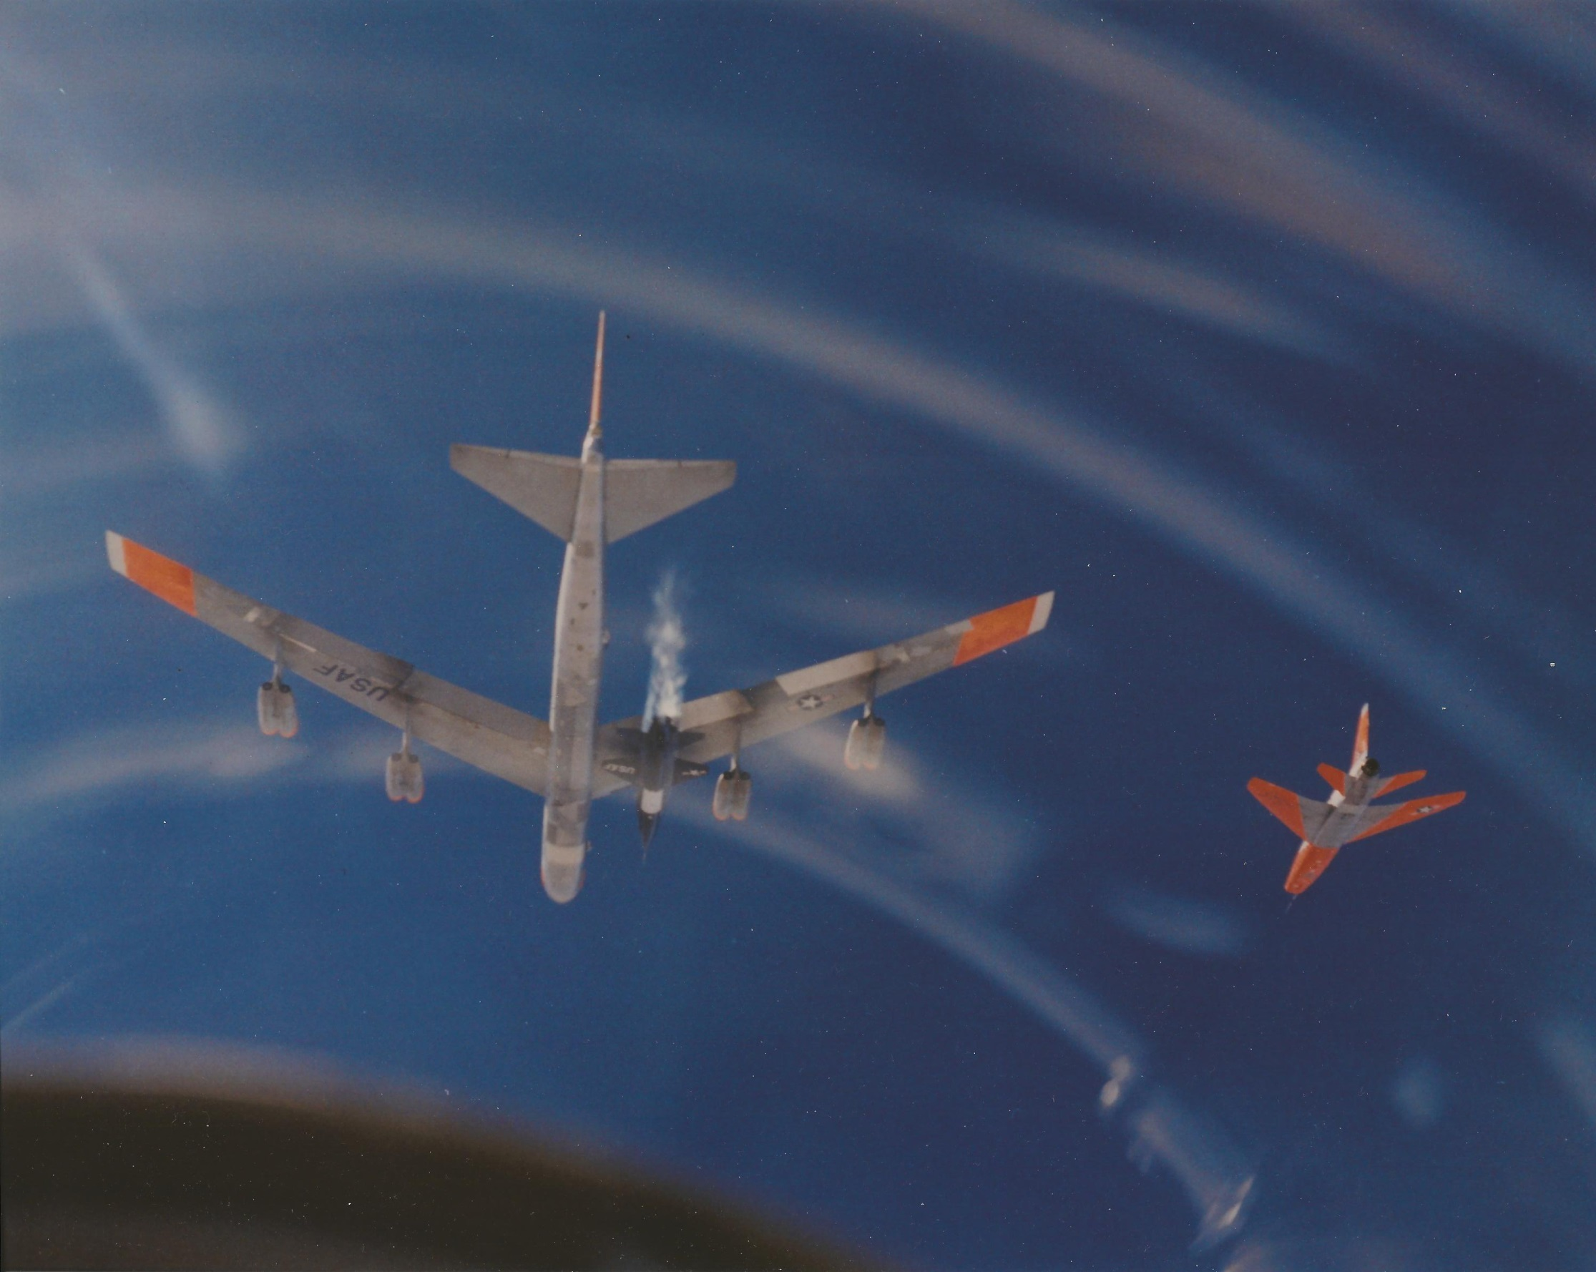

Slide 21
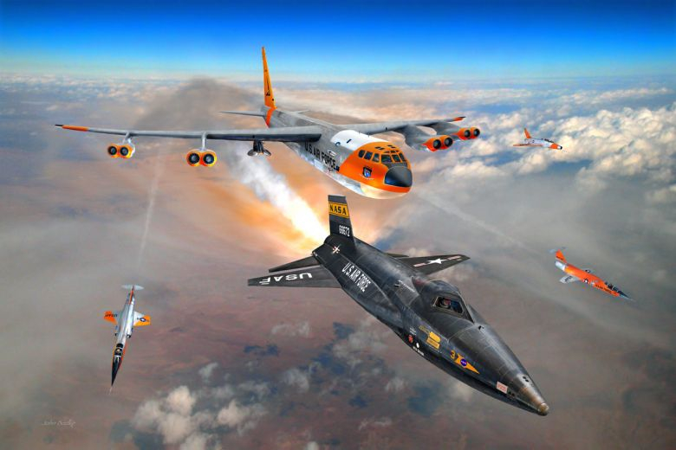
Art by John Bedke

Slide 23
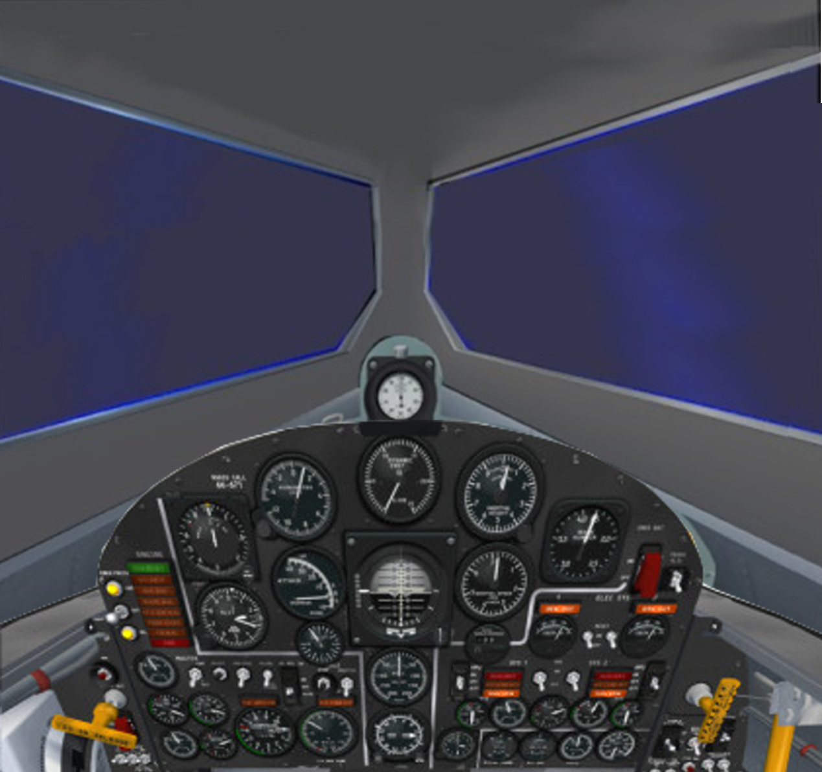
At Drop…
0 min 0 sec
600 mph
45,000 feet
1 second:
Rocket engine
lights.
3.2 seconds:
Full thrust
2G’s acceleration

Slide 24
~ 0 min 15 sec
1,000 mph
44,000 feet
Starting pullup
to climb attitude
Acceleration
increasing
as fuel burns

Slide 25
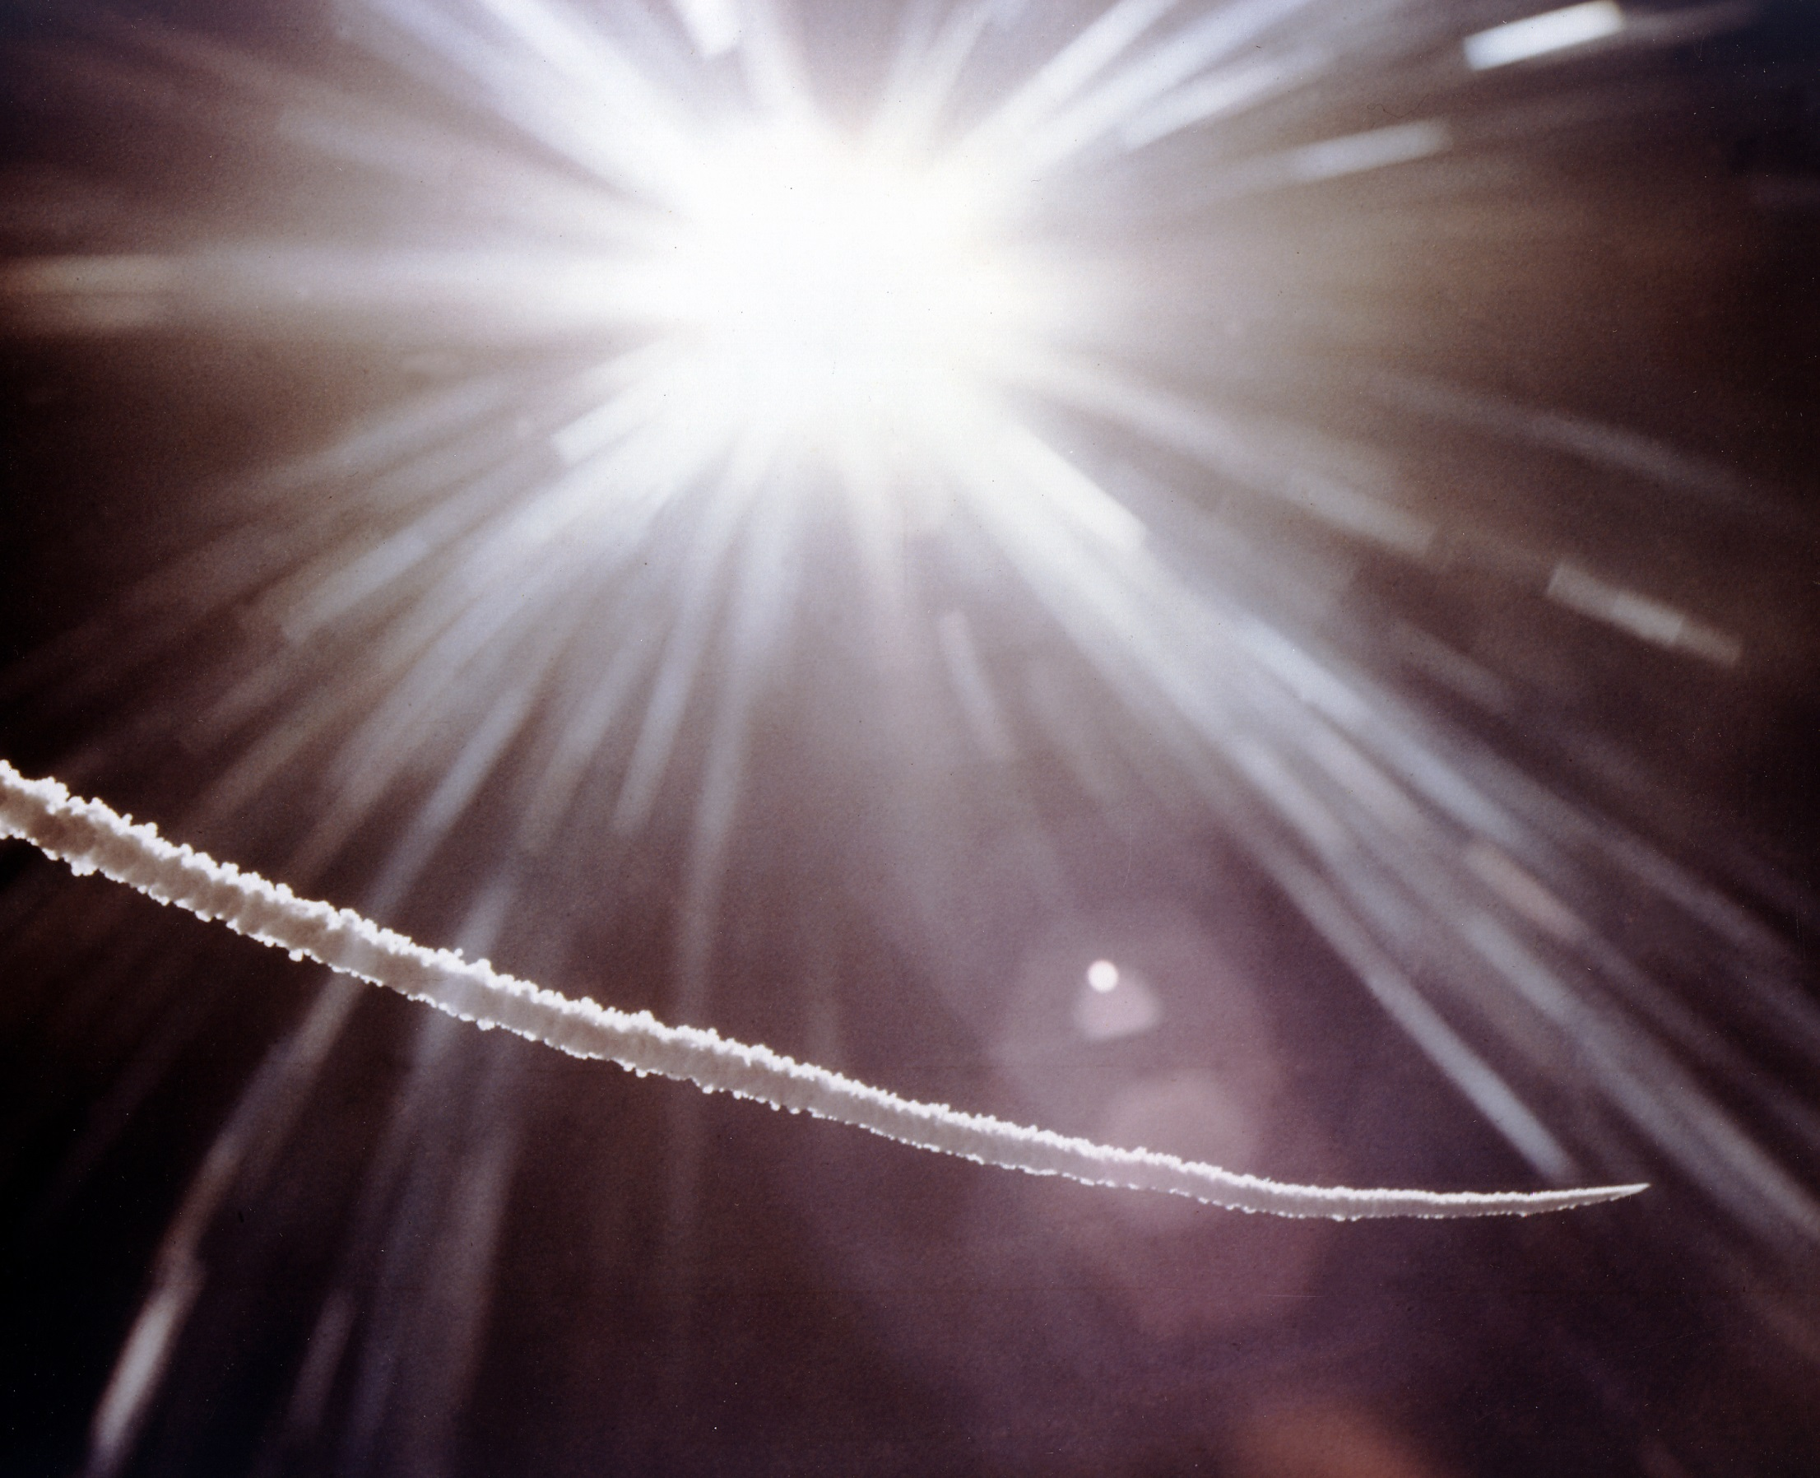

Slide 26
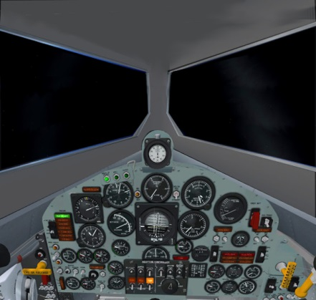
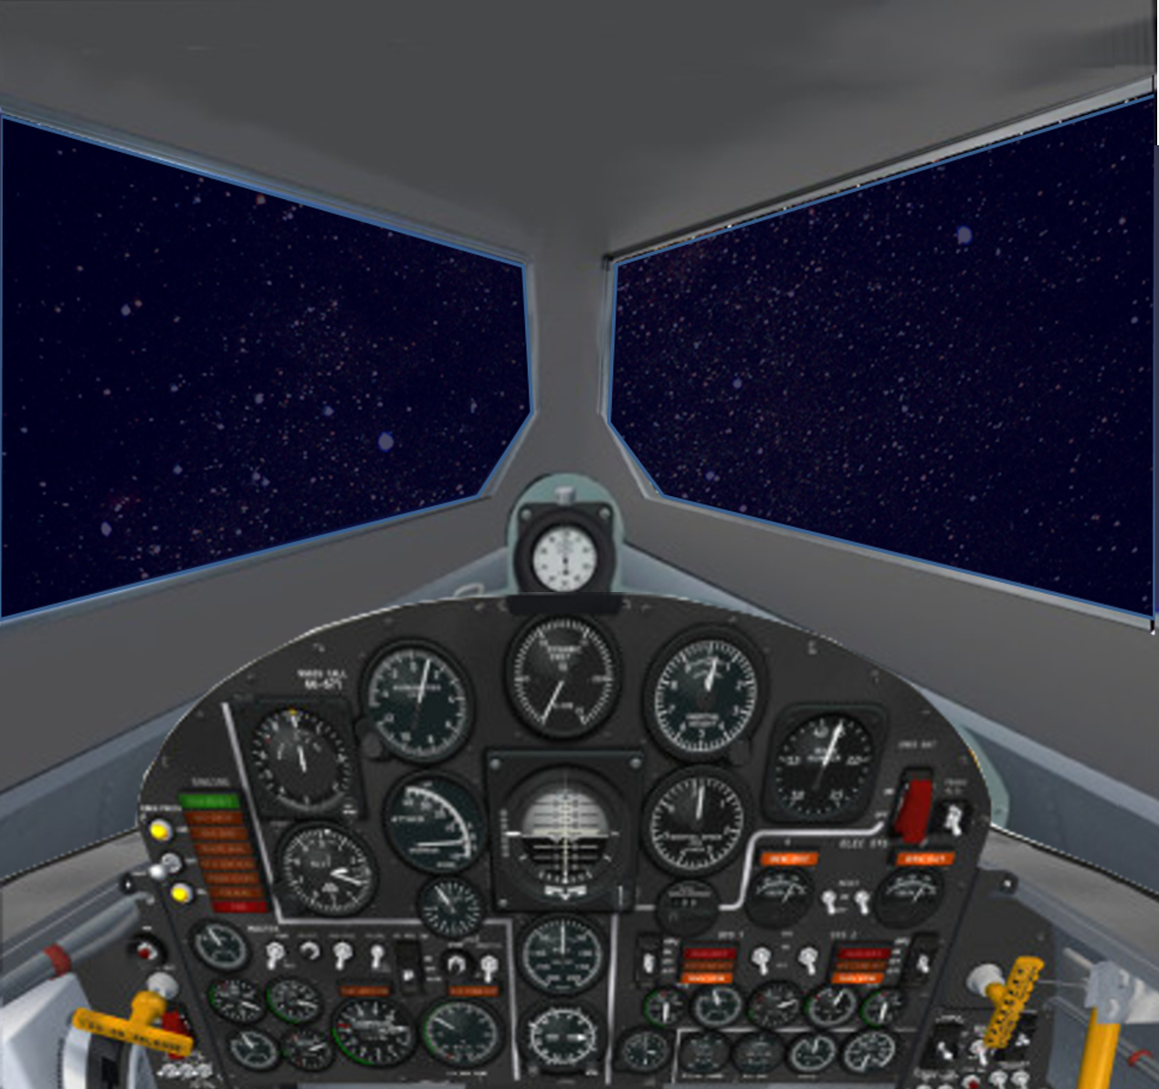
~ 0 min 30 sec
1,365 mph
55,000 feet
Sky going to
black,
Acceleration
increasing,
will reach 4G
before shutdown

Slide 27
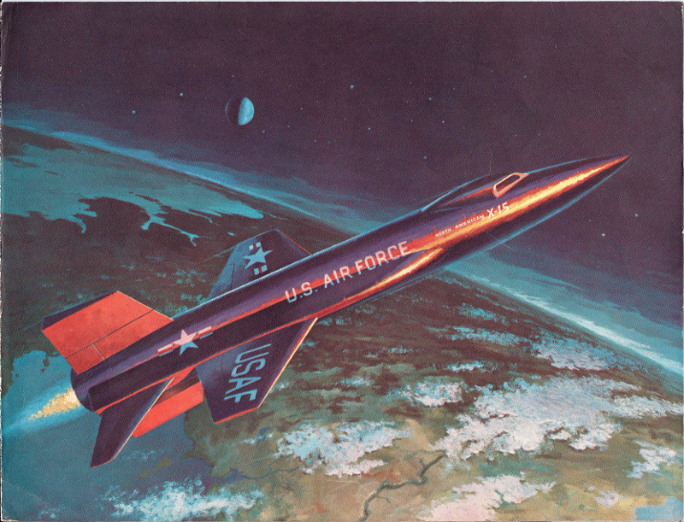

Slide 29
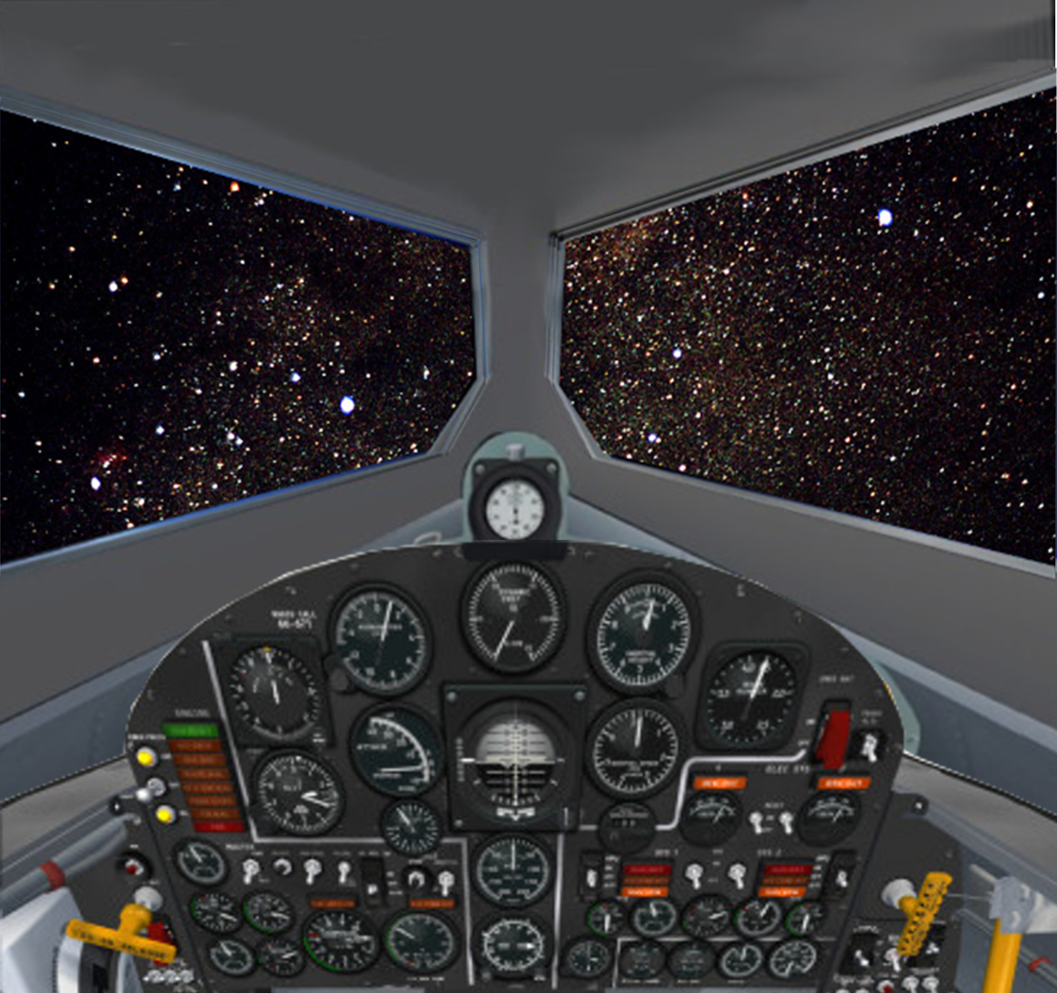
SHUTDOWN
rocket engine burnout
1 min 23.0 sec
3,545 mph
156,000 feet
Acceleration
drops abruptly
from 4G to 0G

Slide 30
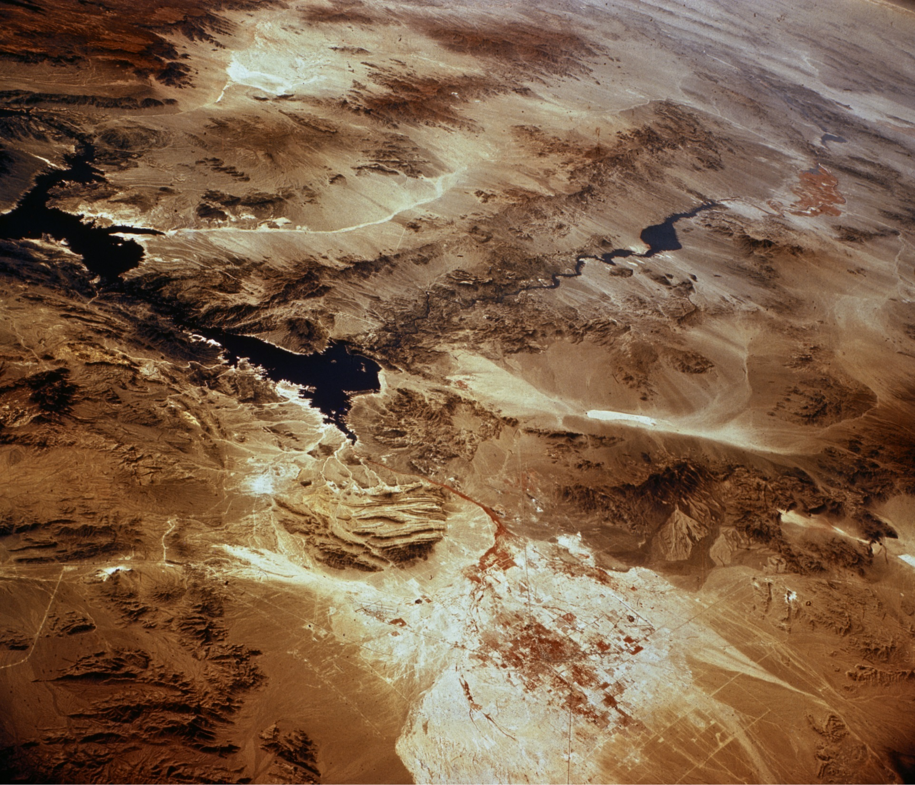
half way
to apogee

Slide 31
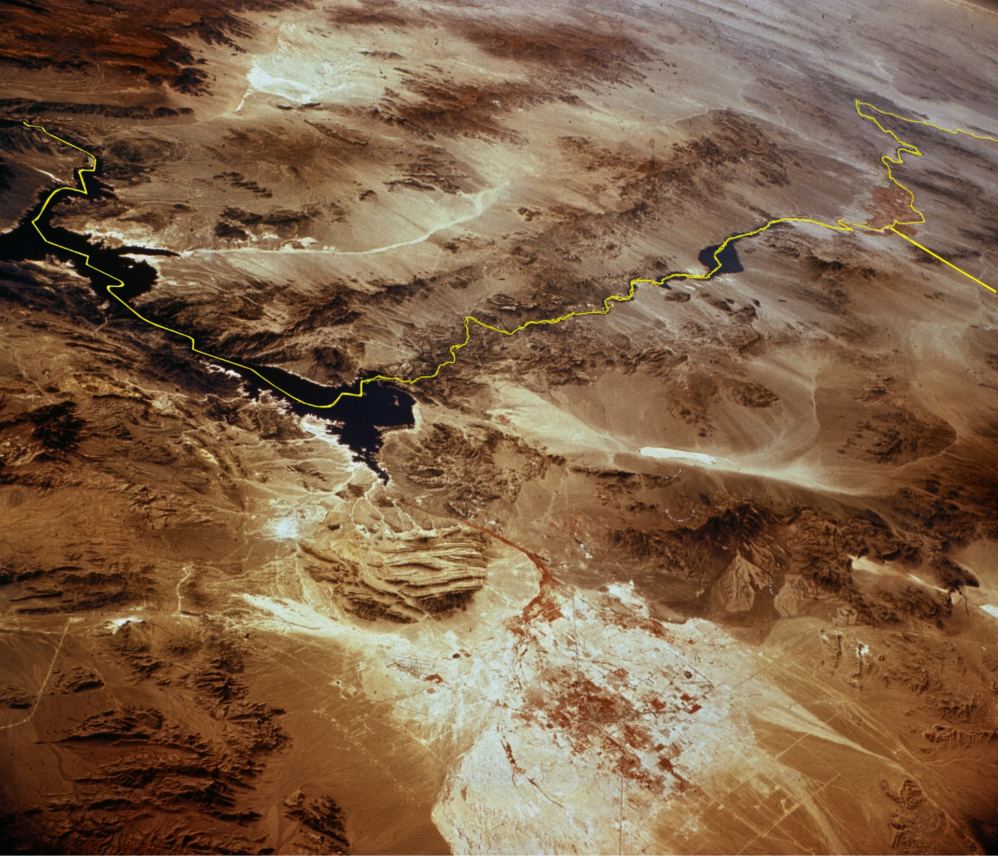
Arizona
half way
to apogee
California
Lake Mead
Nevada
Las Vegas

Slide 32
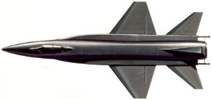
1:50
225,000 ft

Slide 33
2:00
244,000 ft

Slide 34
2:10
260,000 ft

Slide 35
2:20
275,000 ft

Slide 36
2:30
287,000 ft

Slide 37
2:40
297,000 ft

Slide 38
2:50
304,500

Slide 39
3:00
310,000 ft

Slide 40
3:10
313,500 ft

Slide 41
3:20
314,750 ft
Apogee

Slide 42
Pilot Robert M. White wrote…
… at my highest altitude I could turn my head through a 180º arc and wow! - the earth is really round.
… there was that dramatic view of earth's curvation, but there was a band of light around the earth before fading into the darkness of space. The band of light was, of course, the diffusion of sun light through our atmosphere.

Slide 43
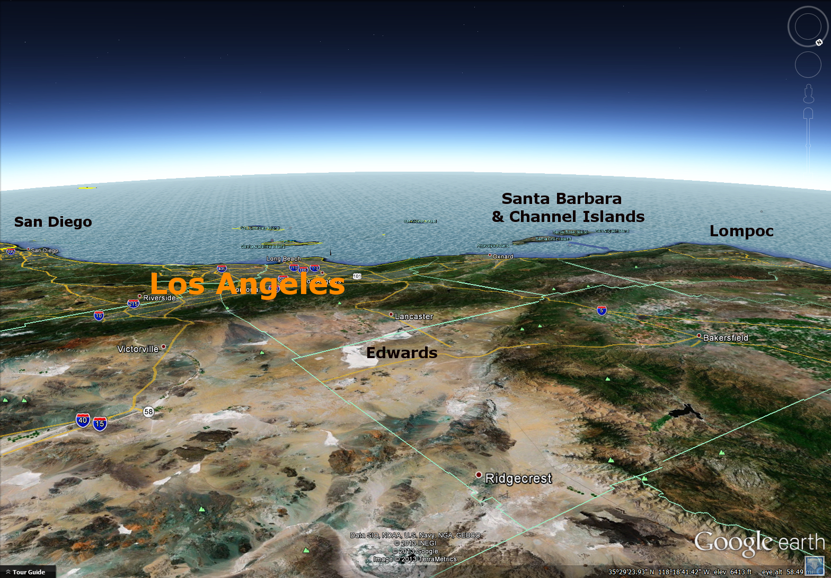

Slide 46
Higher energy than planned
will produce VERY high, VERY fast
arrival overshooting Edwards
4:40
245,600 ft
3,335 mph

Slide 47
Higher energy than planned
will produce VERY high, VERY fast
arrival overshooting Edwards
4:50
227,000 ft
3,450 mph

Slide 48
5:00
206,500 ft
3,575 mph

Slide 49
5:10
183,500 ft
3,705 mph

Slide 50
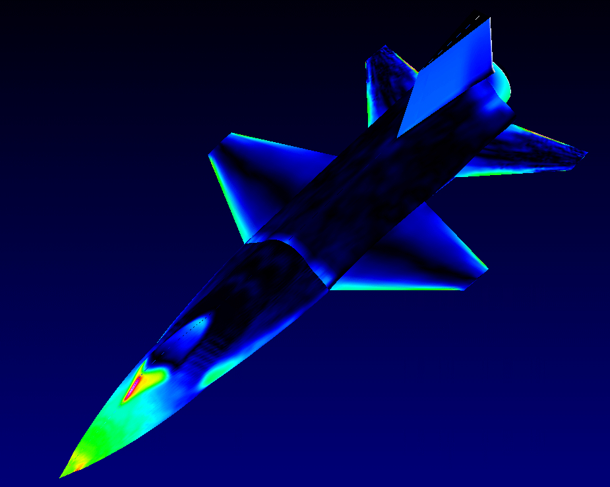
Starting soon: Reentry
Pressure quickly rises VERY high
on parts of the airframe

Slide 51
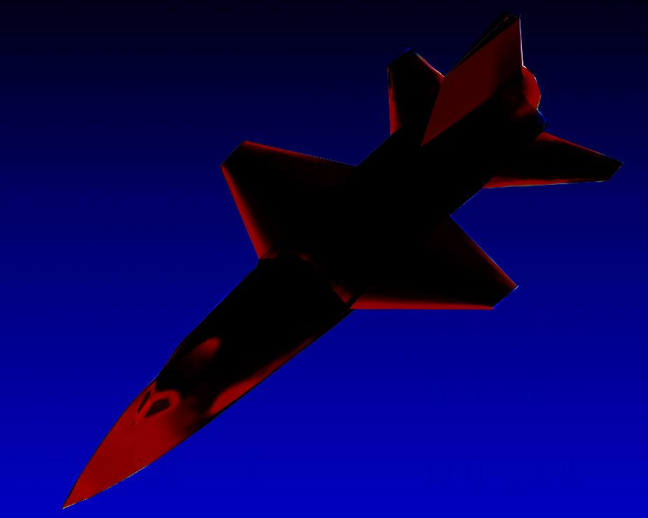
… Those parts heat to 1,200º F
and glow dull red

Slide 52
5:20
158,500 ft
3,832 mph
Top speed for this flight, Mach 5.45
Starting Reentry

Slide 53
5:30
123,000 ft
3,675 mph
Beginning pullup in reentry,
Pullup G force 1G

Slide 54
5:40
93,000 ft
3,400 mph
Reentry pullup at 5.0G
Aerodynamic slowing ~ 3G
Total load ~ 6G

Slide 55
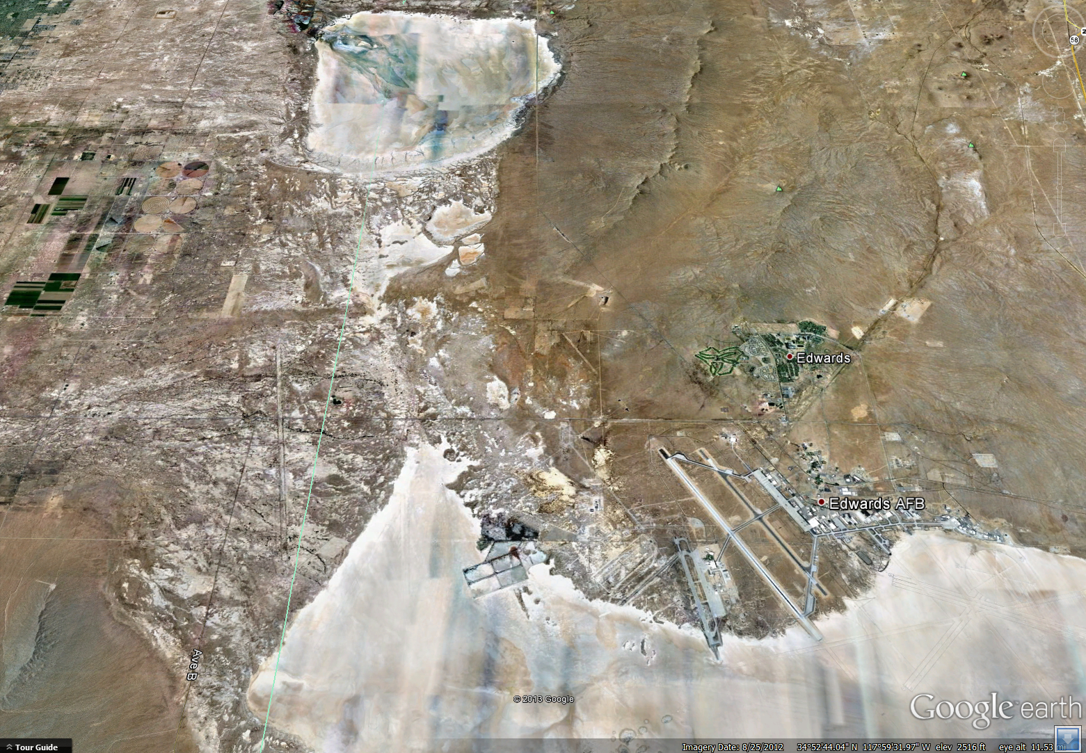
5:50
73,000 ft
2,850 mph
X-15 right-side view of Edwards, starting high-G windup turn

Slide 56
6:00
63,000 ft
2,242 mph
High
Key
High-G windup turn
maximizes slowing
while turning back

Slide 57
Mach 3
6:10
60,000 ft
1,770 mph
End of Reentry
High
Key

Slide 58
6:20
58,500 ft
1,700 mph
High
Key

Slide 59
Mach 2
6:30
56,550 ft
1,424 mph
High
Key

Slide 60
6:40
53,660 ft
1,150 mph
High
Key

Slide 61
6:50
50,350 ft
895 mph
High
Key

Slide 62
7:00
47,000 ft
690 mph
High
Key

Slide 63
Mach 1
7:10
43,300 ft
503 mph
High
Key

Slide 64
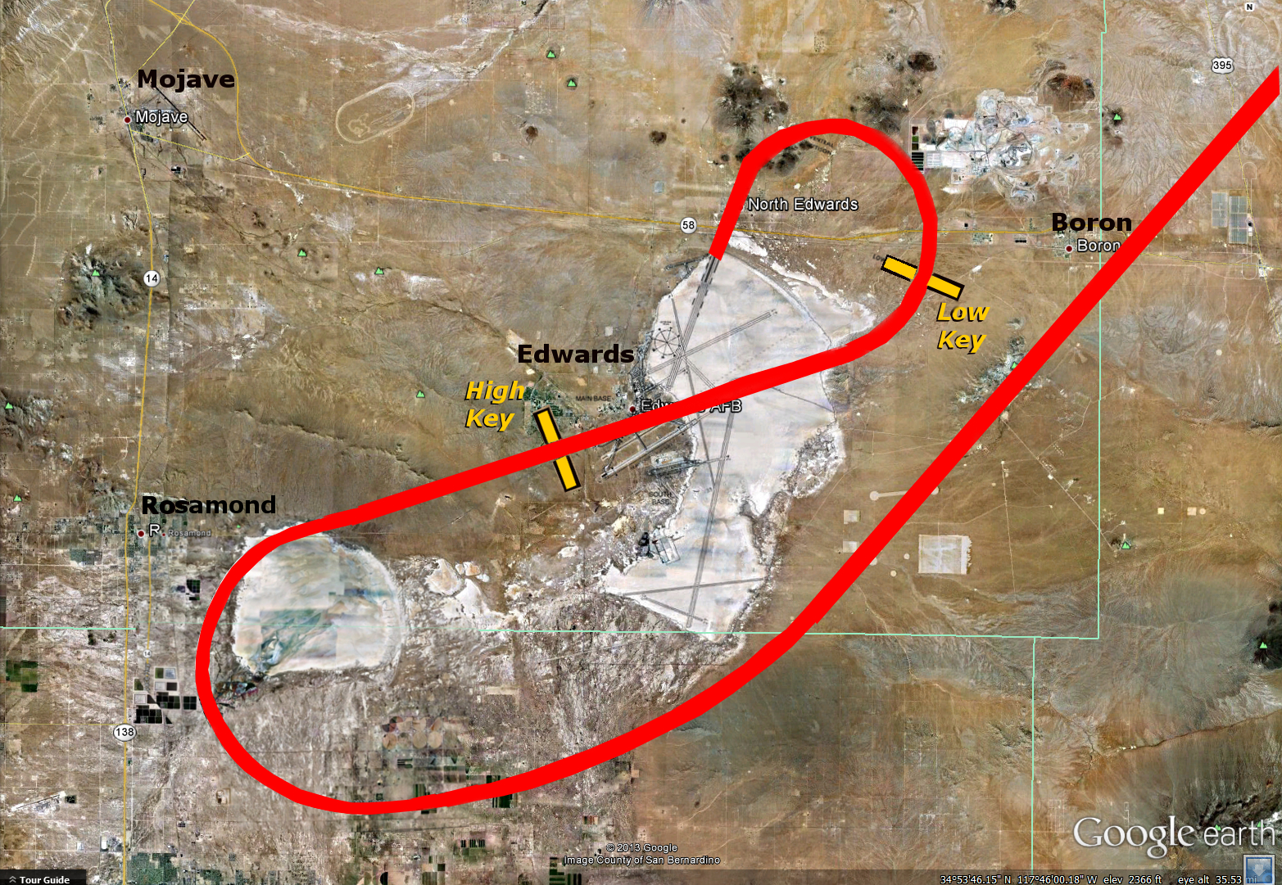
“Going to jettison” … Chase 4 (F-104B) joining up
7:20
39,725 ft
418 mph
High
Key

Slide 65
7:30
36,420 ft
367 mph
High
Key

Slide 66
7:40
33,400 ft
350 mph
High
Key

Slide 67
High Key for landing
7:50
30,500 ft
345 mph
High
Key

Slide 68
8:00
27,770 ft
345 mph
High
Key

Slide 69
8:10
25,250 ft
345 mph
High
Key

Slide 70
8:20
22,725 ft
345 mph

Slide 71
8:30
20,200 ft
345 mph

Slide 72
8:40
17,675 ft
345 mph
High
Key

Slide 73
8:50
15,150 ft
345 mph
High
Key

Slide 74
9:00
12,625 ft
345 mph
High
Key

Slide 75
9:10
10,100 ft
345 mph
High
Key

Slide 76
9:20
7,580 ft
345 mph
High
Key

Slide 77
9:30
5,050 ft
345 mph
High
Key

Slide 78
Starting landing flare, 1.5 G pullup
9:40
3,375 ft
327 mph
High
Key

Slide 79
30 seconds to touchdown
9:50
2,770 ft
295 mph
High
Key

Slide 81
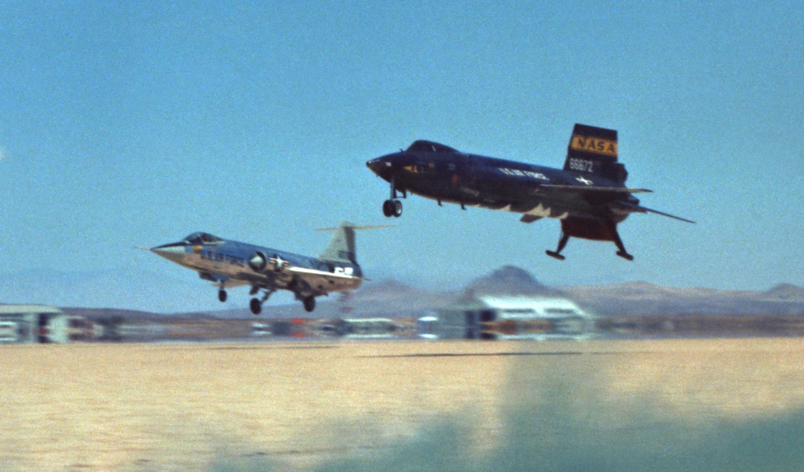
Encore…
A second video clip of landing…

Slide 83
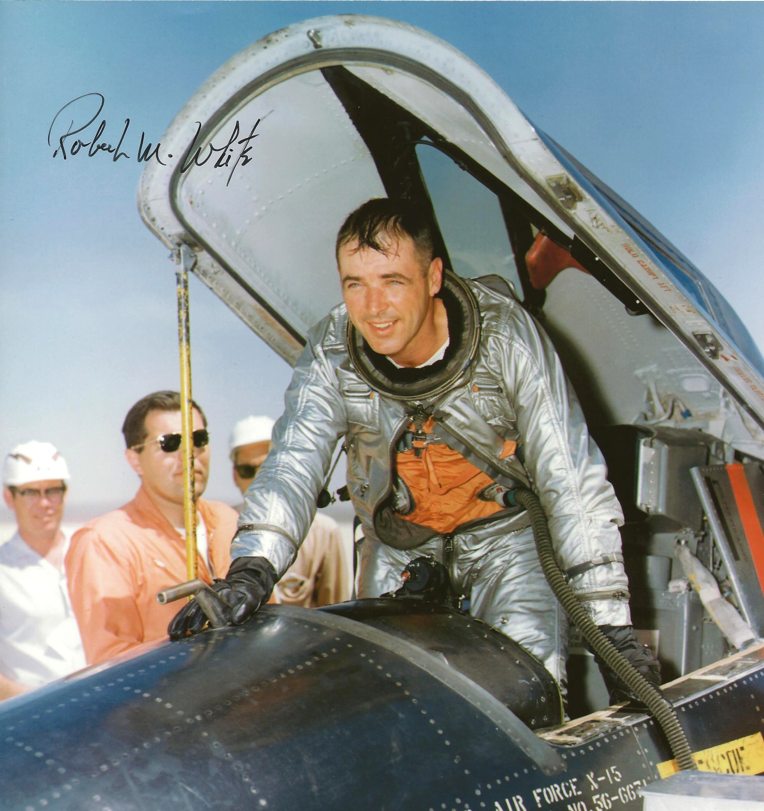

Slide 84
Piloting skill, by the numbers
 | Planned | Actual
Powered Climb Angle | 41 degrees | 41.16 degrees
Unplanned: Downrange overshoot passing Edwards at Mach 3 (~2,000 mph) at 60,000 feet
High Key: | 29,000 feet at 345 mph (300 kt) | 29,000 feet At 345 mph (300 kt)
Touchdown Speed | 200 kt | 198 kt indicated 201 kt true
Distance from ideal touchdown |  | 50 feet

Slide 85
Some of Robert M. White’s other X-15 records
First to break Mach 4
First to break Mach 5
First to break Mach 6
During X-15 program expansion of the flight envelope
Major White and Joe Walker (NASA) routinely swapped records every week.
Usually one set a new altitude record, the other set a new speed record.

Slide 86
About the research pilot, USAF Major Robert M. White…
USAF war-time flight experience: WW-II, 52 combat missions in P-51s Korea, 514th Troop Carrier wing Viet Nam, 70 combat missions
During USAF service, earned Bachelor’s degree in aeronautical engineering, Masters in business administration
USAF test pilot and X-15 research pilot, ~ 1958-1962
Later command positions included Air Force Flight Test Center at Edwards AFB, Director of F-15 Systems Development, Chief of Staff of Fourth Allied Tactical Air Force.

Slide 87
About the research pilot, USAF Major Robert M. White…
Held rank of Major as X-15 research pilot and USAF test pilot
Ultimate rank was 2-Star Major General
Military Honors: AF Cross, AF Distinguished Service Medal, Silver Star with 3 bronze oak leaf clusters, Legion of Merit, Distinguished Flying Cross with 4 bronze oak leaf clusters, Bronze Star Medal, Air Medal with 3 silver & 1 bronze oak leaf clusters, AF Outstanding Unit Award with Valor device
Civil Honors: NASA Distinguished Service Medal, 1960 Harmon International Trophy, 1961 Collier Trophy, FAI Silver Medal for altitude record
The Harmon and Collier trophies were personally presented by President John F. Kennedy.

Slide 88
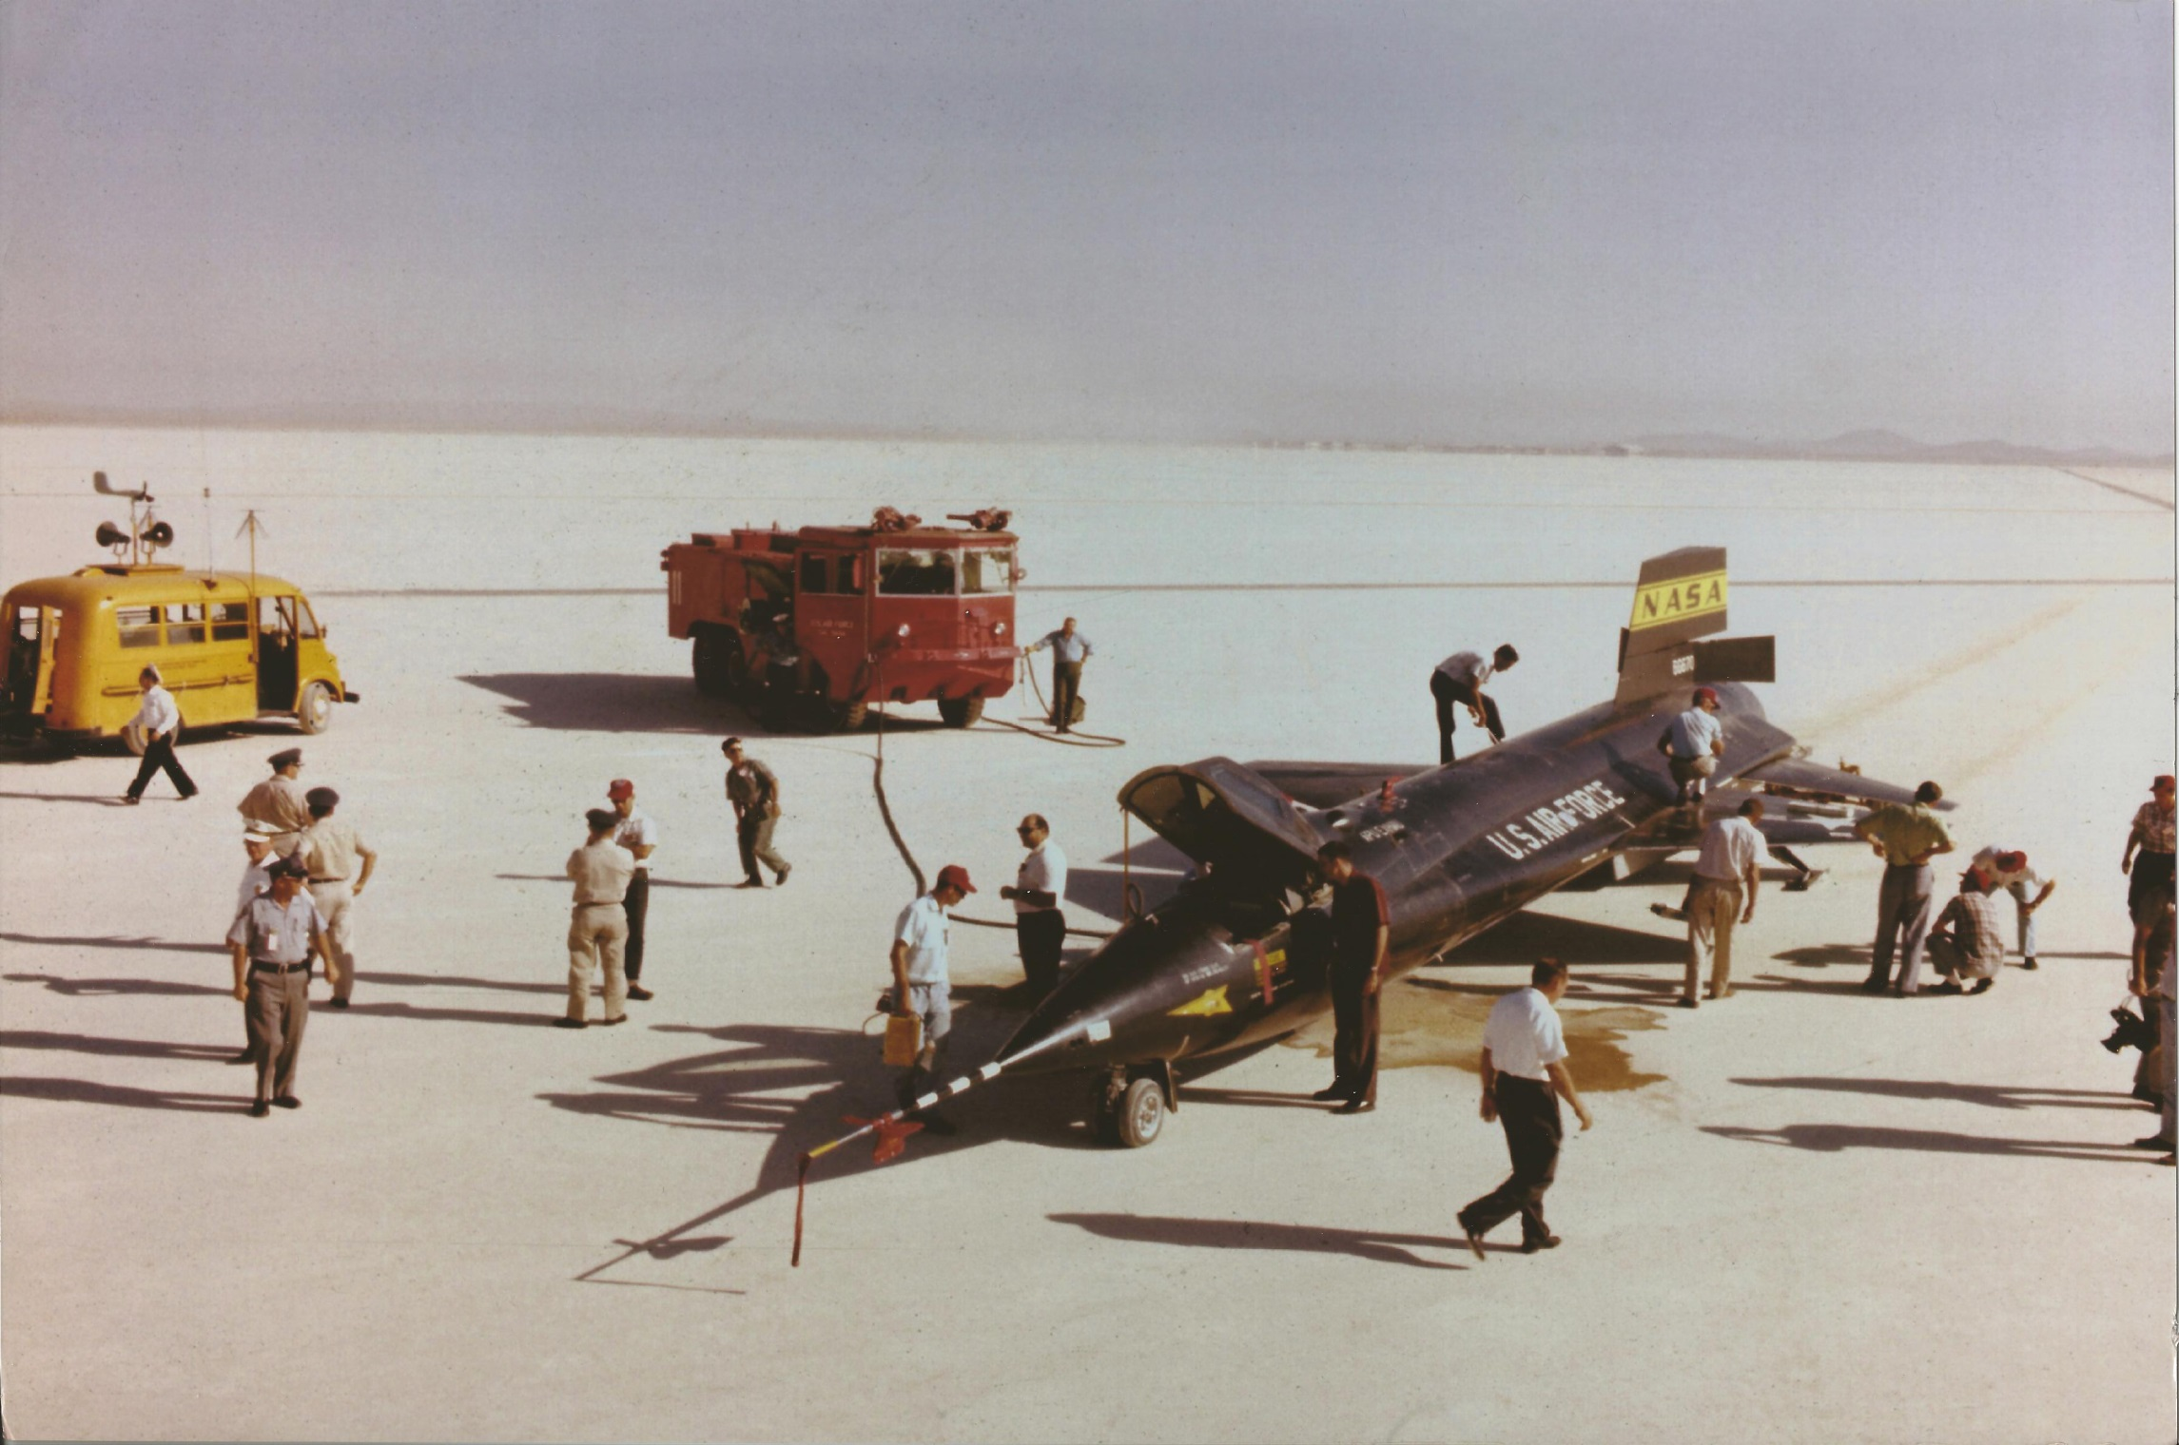

Slide 89
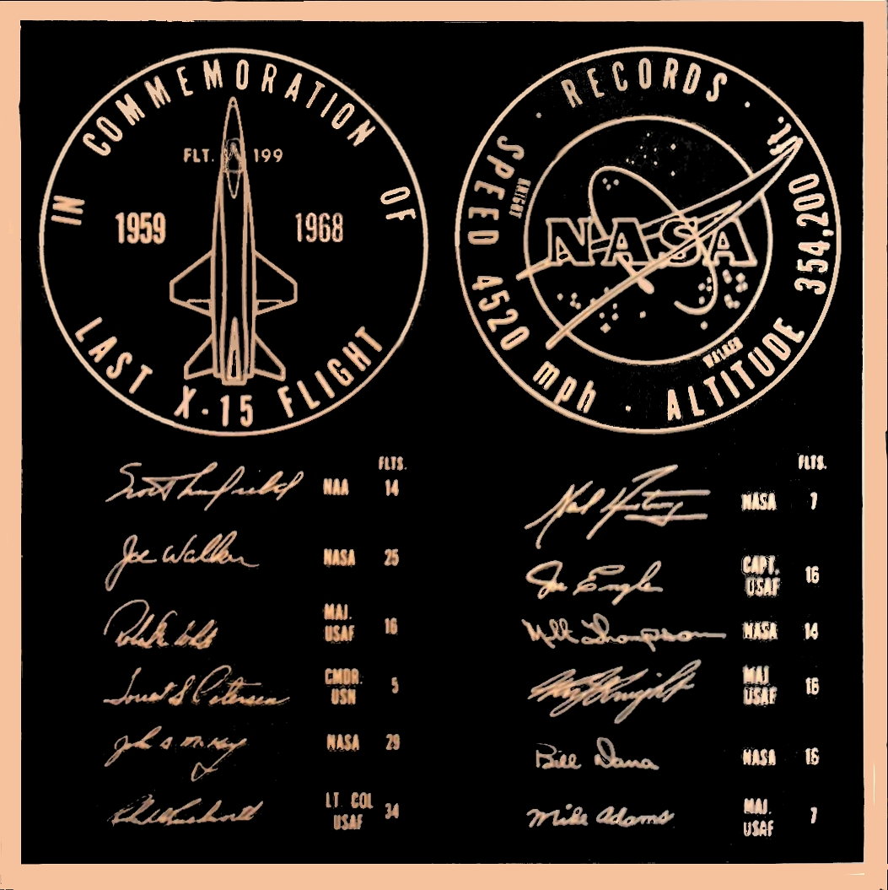

Slide 90
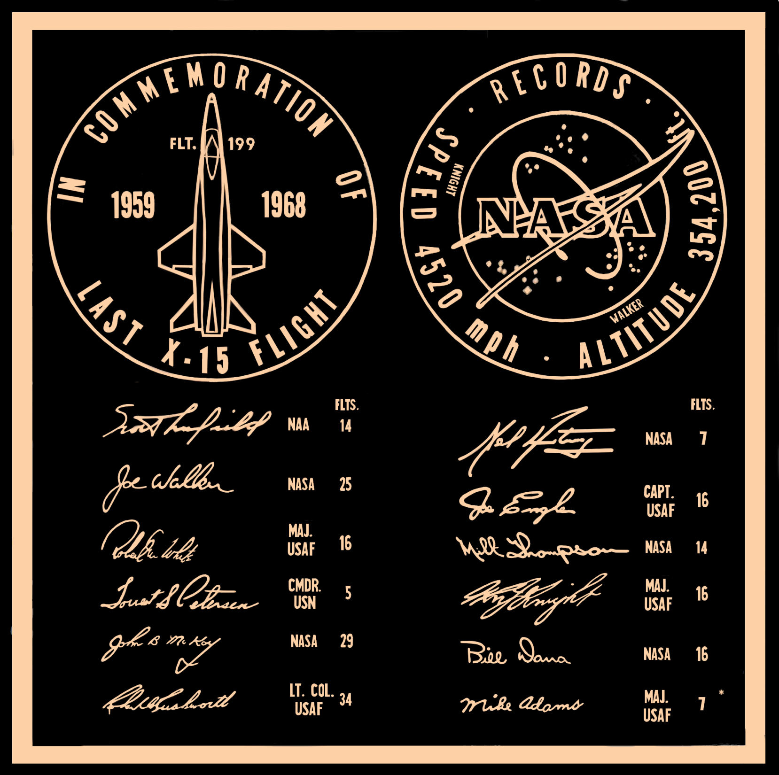

Slide 91
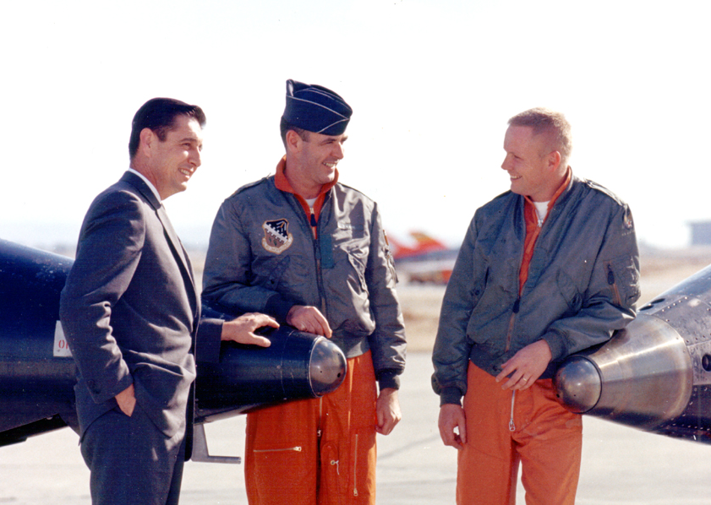
Scott Crossfield Major Robert M White Neil Armstrong
North American Aviation USAF NASA

Slide 92
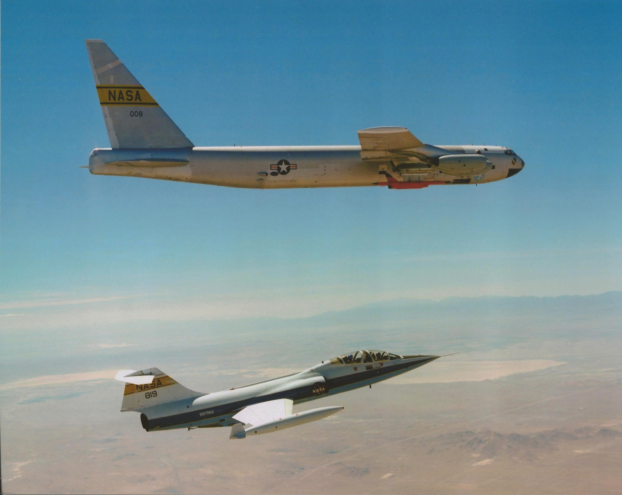
F-104B NASA 819, originally USAF 57-1303
Flew as Chase 4 on this world altitude record flight
Now at the Aerospace Museum of California in Sacramento, at McClellan Park

